Slide 1

FINAL MAJOR PROJECT
WEEK 1

Slide 2
Recap of the Basics
10 weeks (middle of May completion)
Marked Pass / Merit / Distinction

Slide 3
Marking Criteria
Context
Research
Problem Solving
Planning and Production
Practical Skills
Evaluation and Reflection
Presentation
Each of these criteria are marked Pass, Merit, Distinction.
You take home your lowest grade.

Slide 4
Job Roles
Everyone has an individually assigned job role.
Your FMP will center around the work you do in that job role to support the final project.
No matter where your job role may fall in the production process, you will be expected to demonstrate evidence for all of the key Assessment Criteria and must contribute fully across the full length of the project.

Slide 5

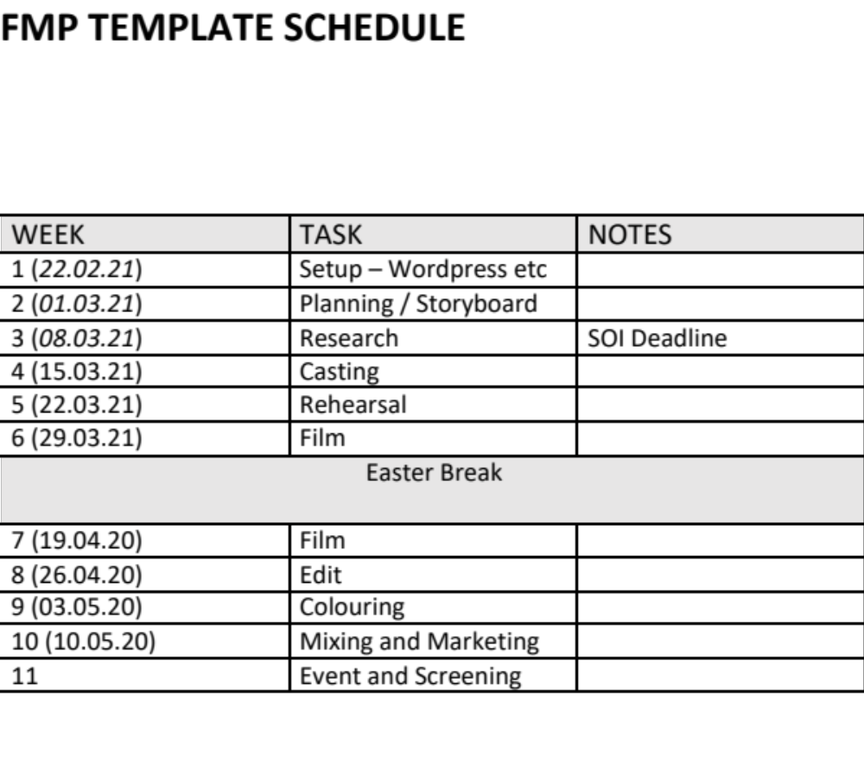
Production Schedule

Slide 6

Preparation
It is not enough to complete great work, you have to evidence what you have done so that the examiner can see it. This is just as important as the final product. It helps show what you have done, and why you did it.
TASK
To do this, you need to create a new Wordpress / Wix page for your Final Major Project. Name it appropriately in the following format karlfalconerFMP.wordpress.com and add three tabs for Pre-Production, Production, Post-Production.

Slide 7

Accessing Work
Microsoft Teams Document Folder
Microsoft Teams Notebook

Slide 8

Set up for Success
-FMP Top Tips: https://northernart.ac.uk/final-major-project-best-thing-will/
’Don’t treat this as something you need to ‘pass’, treat this as the real deal’
Example Distinction FMP:
https://alexanderhummus4.wixsite.com/fmpsite
Why do you think this project obtained the grade it did?

Slide 9

Statement of Intent
The Statement of Intent document simply lays out what your contribution is going to be to the FMP.
Deadline for completion: 12th March 2021

Slide 10

Homework
1. Listen to any episode of the Team Deakins Podcast relating to your assigned job role. https://teamdeakins.libsyn.com
2. Read the appropriate Job Profile for your role: https://www.screenskills.com/careers/job-profiles/film-and-tv-drama/
3.Complete Section 1 of the Statement of Intent ready to bring to next week’s session.

Slide 11
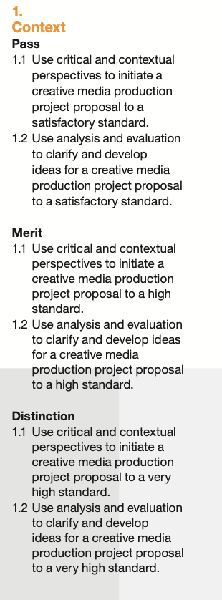
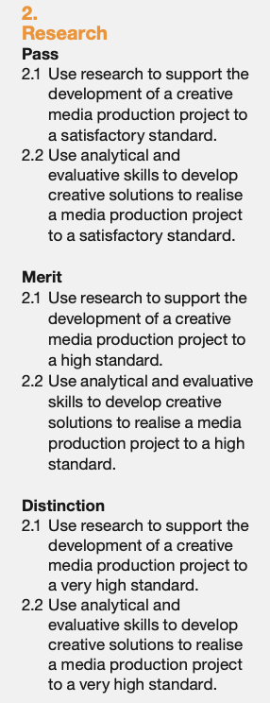
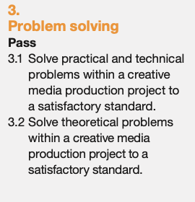
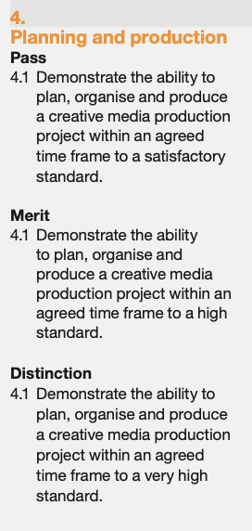
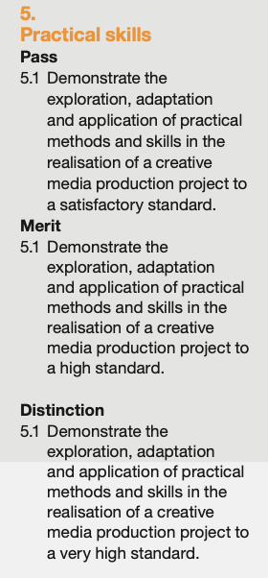
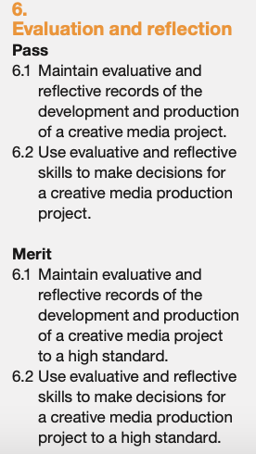
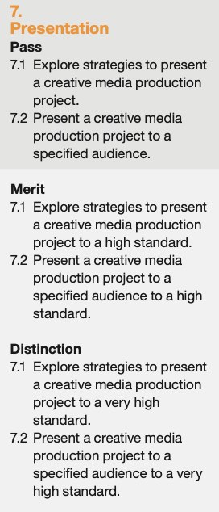
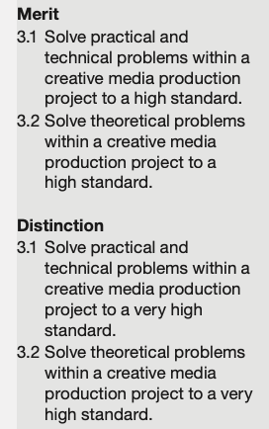
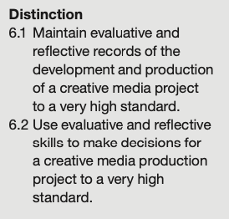
Grading Criteria Full

