Slide 1
Story
Structure

Slide 2

Homework REMINDER
Continue your Terminology Blog with the words from this week.
  Mise-en-scene
  Auteur theory
Watch an episode of Mark Kermode’s Secret of Cinema. Pick a genre of your choice. Summarise what you have learnt about the way the genre has developed over time and write 300 words on your blog, with examples.
https://www.bbc.co.uk/iplayer/episodes/b0bbn5pt/mark-kermodes-secrets-of-cinema

Slide 3
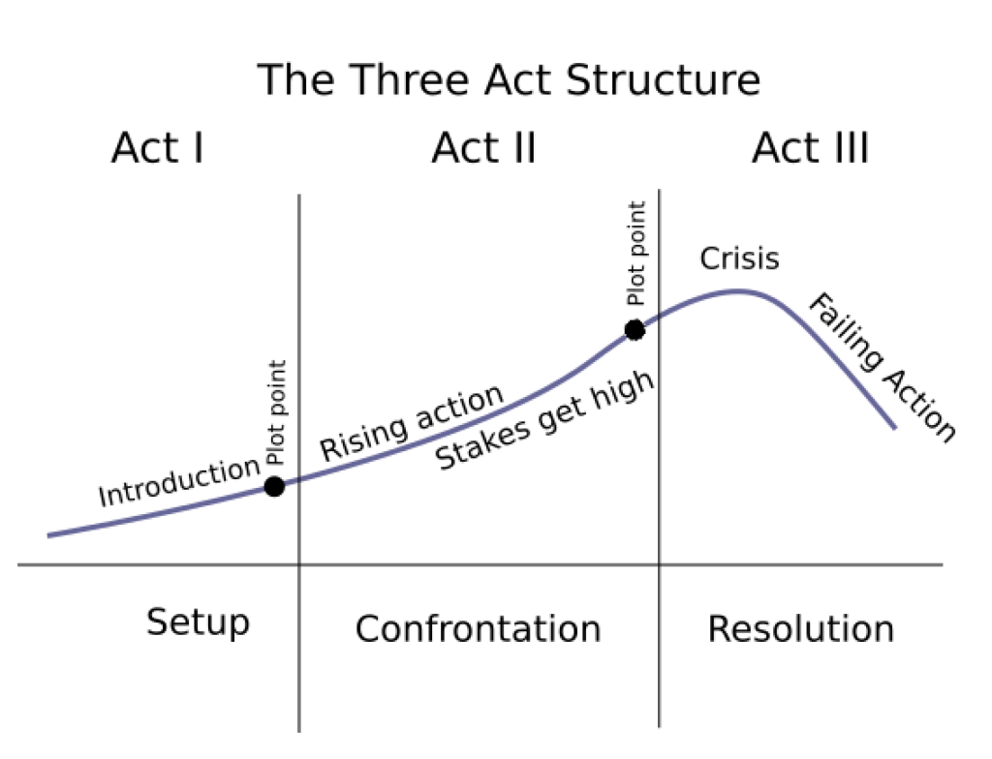
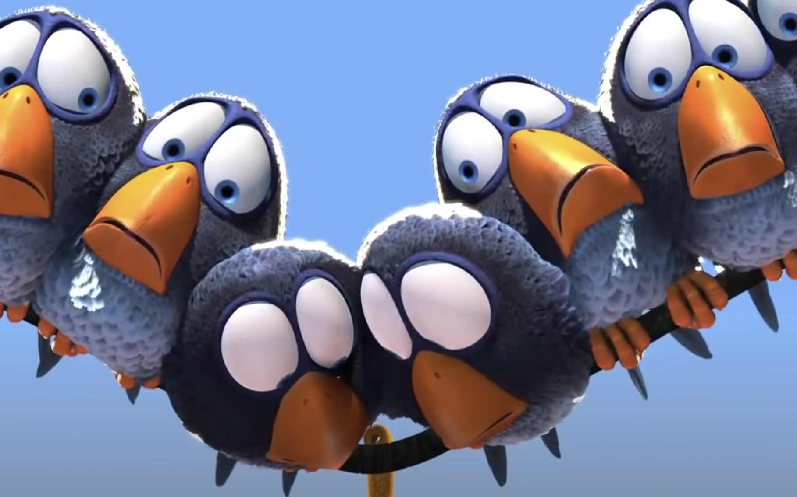
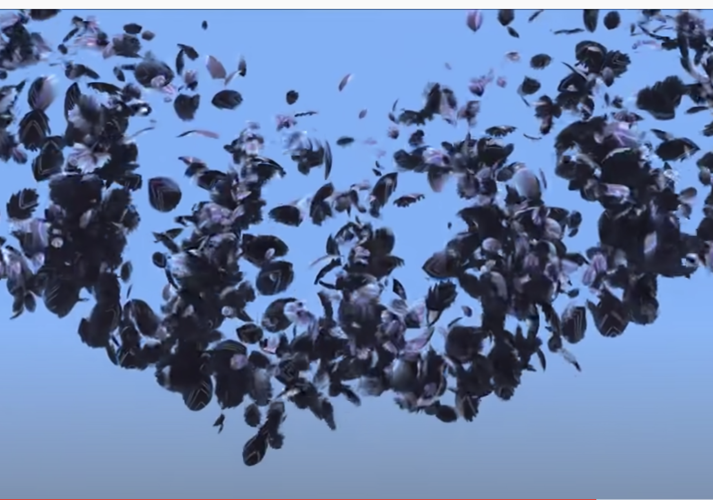
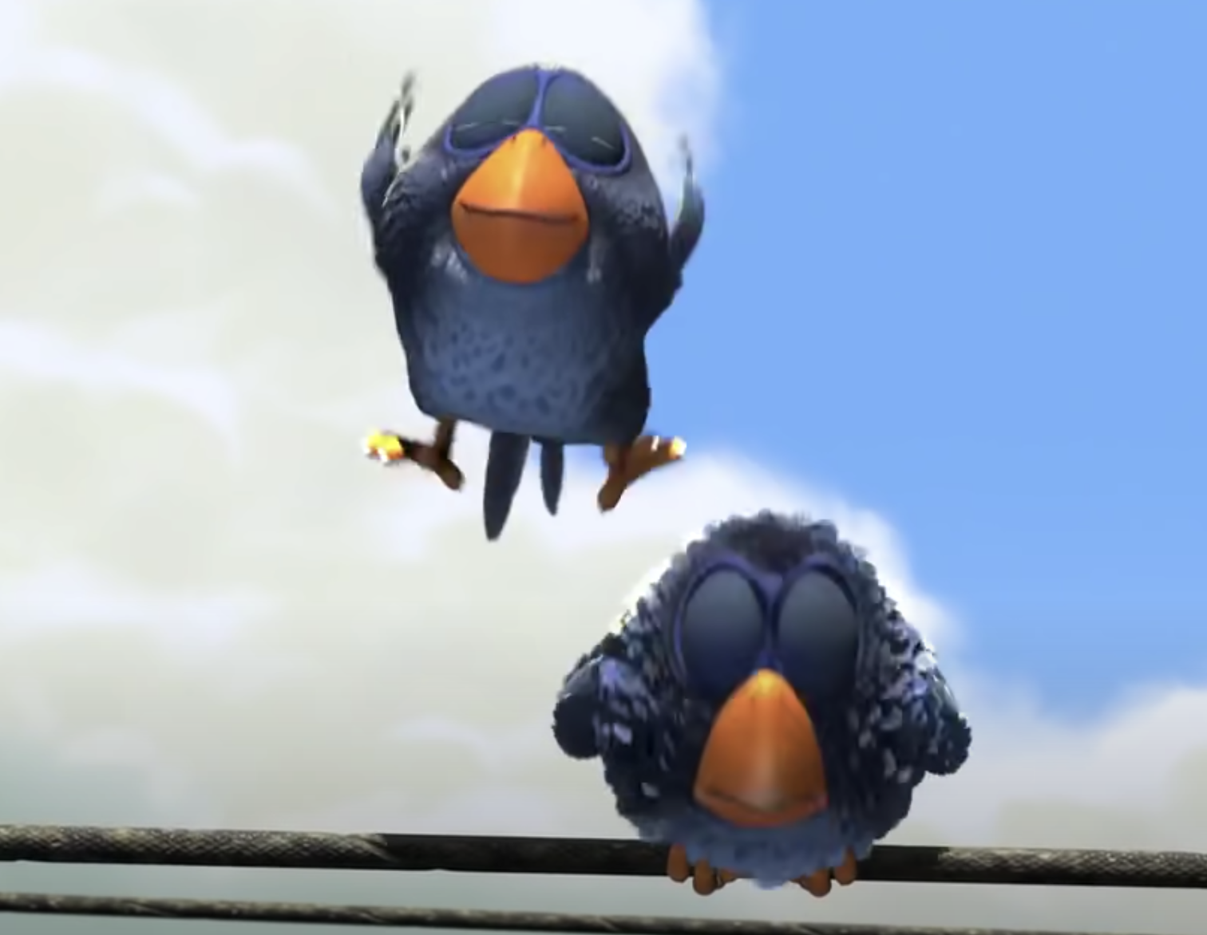
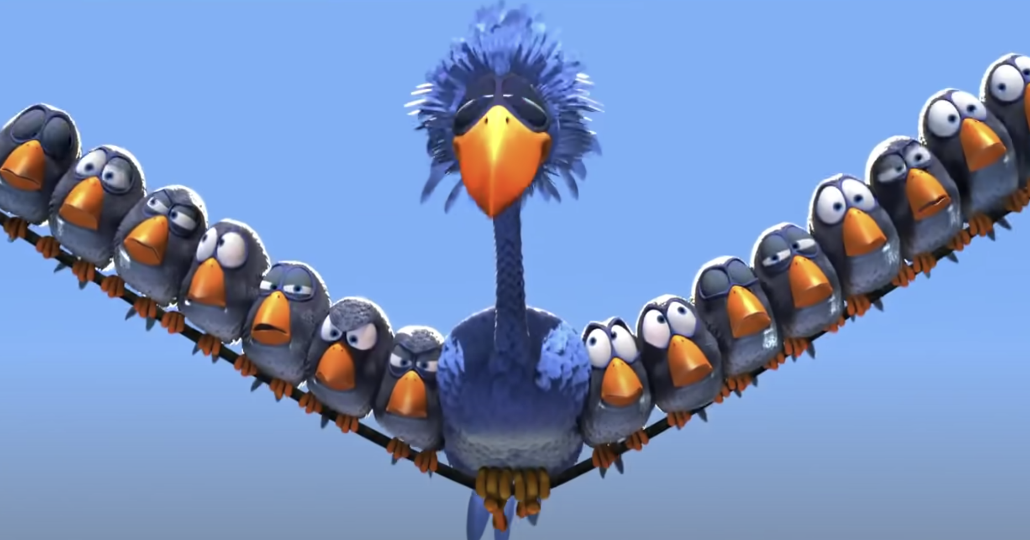
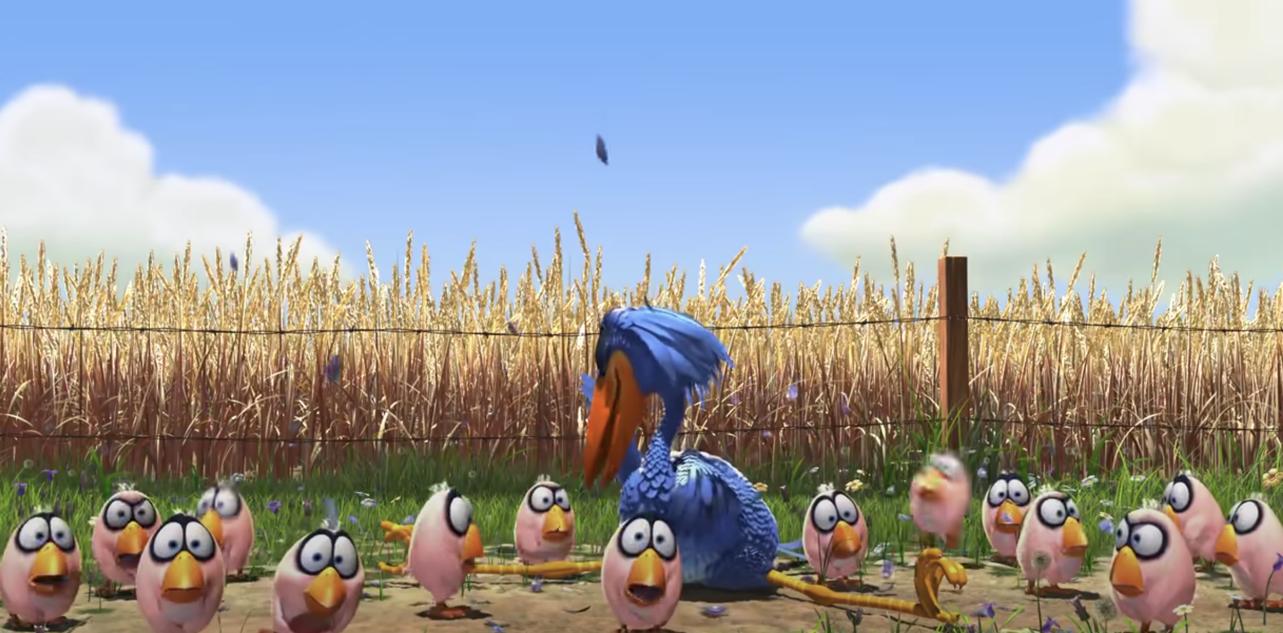
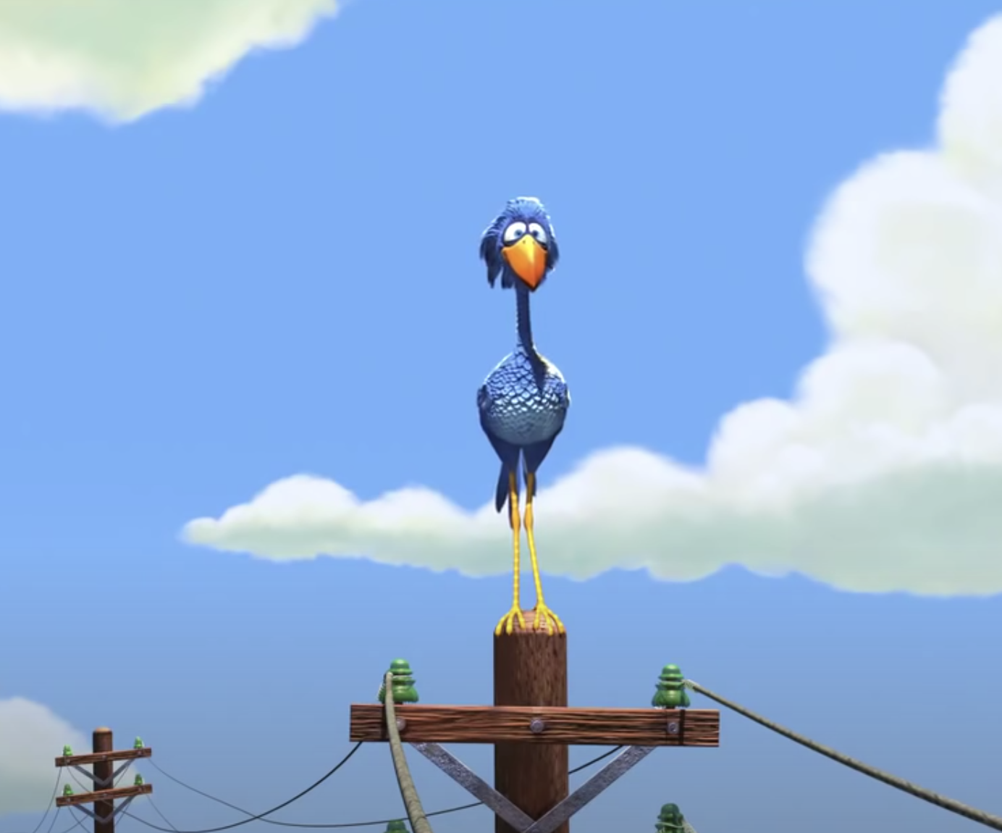
STORY STRUCTURE
A traditional Hollywood movie follows a Three Act Structure. The plot of the film can be mapped to the following story arc.
The Inciting Incident is the moment that begins the story – without this, there would be no plot.
Watch the short film below and identify the key beats on the graph:
https://www.youtube.com/watch?v=nYTrIcn4rjg
Find out more by watching this short video: https://www.youtube.com/watch?v=F7oi_V7JXCg&t=396s

Slide 4
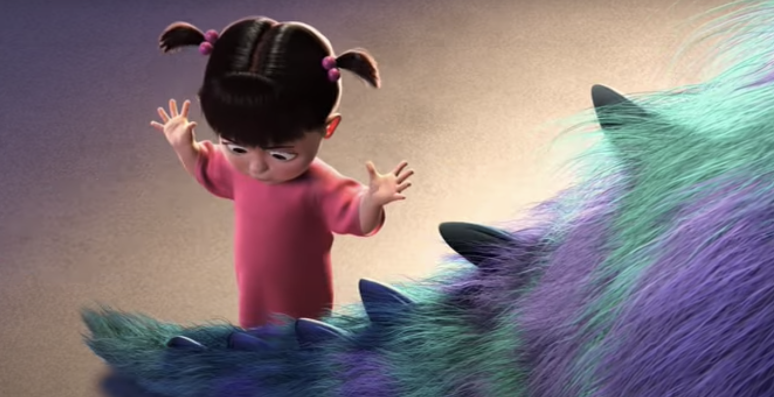
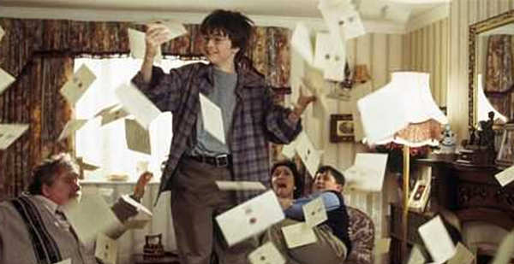
The inciting incident
Think of your favorite film. What is the inciting incident?

Slide 5
Exposition
Sometimes your film needs to explain things in order to get the story started. Harry Potter, for example, needs to tell the audience:
There are Wizards in our world
They go to a magical school called Hogwarts
There’s a bad wizard called Voldermort
Voldemort tried to kill Harry Potter
Harry Potter somehow managed to survive.
This explanation is called Exposition. Exposition is necessary in any film, but it is the writer’s job to provide good exposition that doesn’t bog down the film.
https://www.youtube.com/watch?v=K-z8kWZffYw

Slide 6
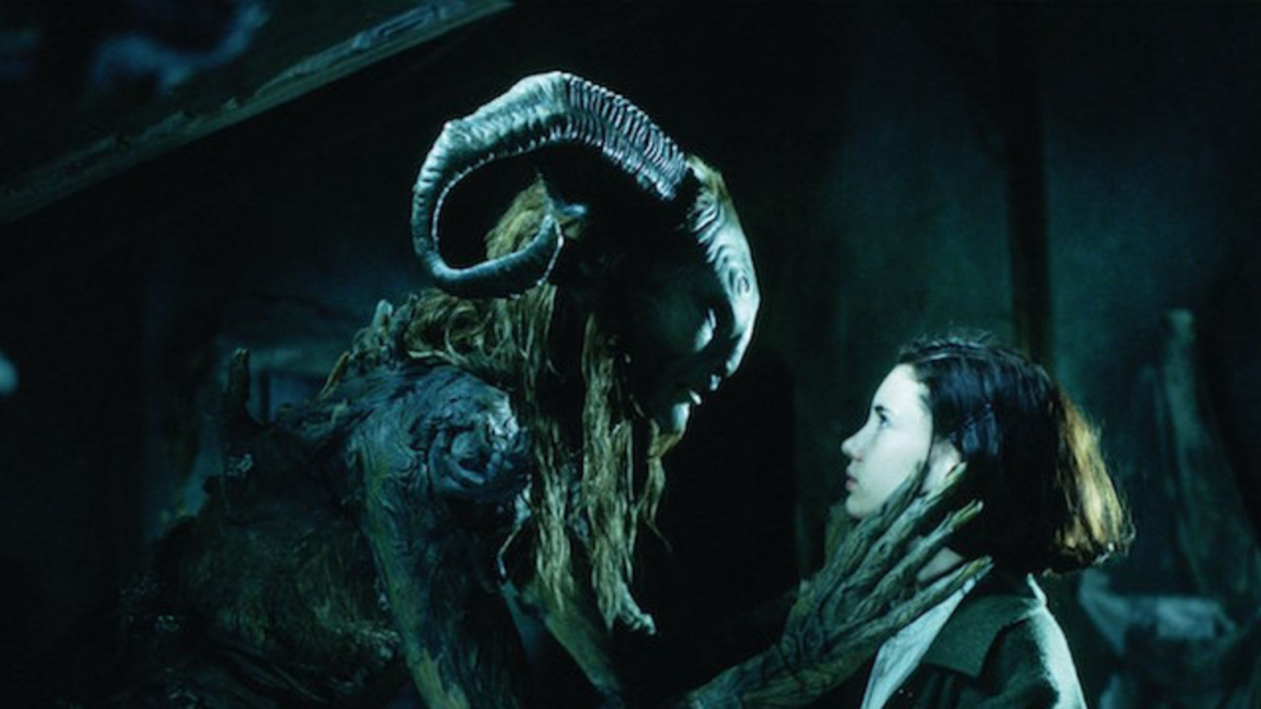
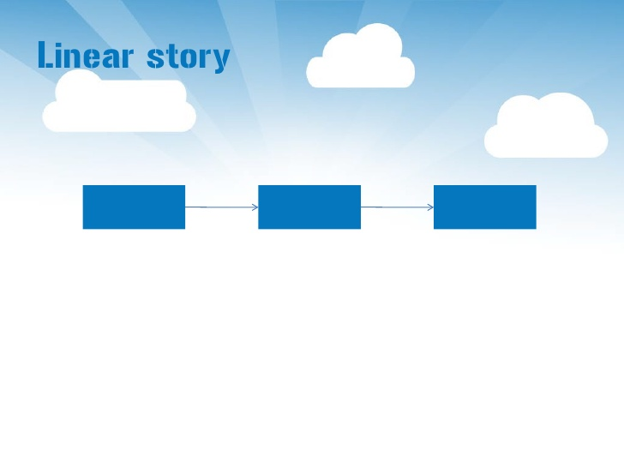
Linear and non-linear Narratives
Most stories have a beginning, middle and end. Most stories unfold in that natural order, starting at the beginning and finishing at the end. This is called a Linear narrative – because the story runs like a straight line.
Films don’t have to be told in this way. Sometimes, films use Prologues and Epilogues to tell us information that happened before or after the main part of a film. Look at the example below, consider how the Prologue is used to give exposition. https://www.youtube.com/watch?v=x2rDrKUb6bM
Films may play around with narrative order to confuse or surprise us. The film Memento is told backwards: starting at the end and ending at the beginning. Tenet is a palindrome: the same backwards as it is forwards.

Slide 7
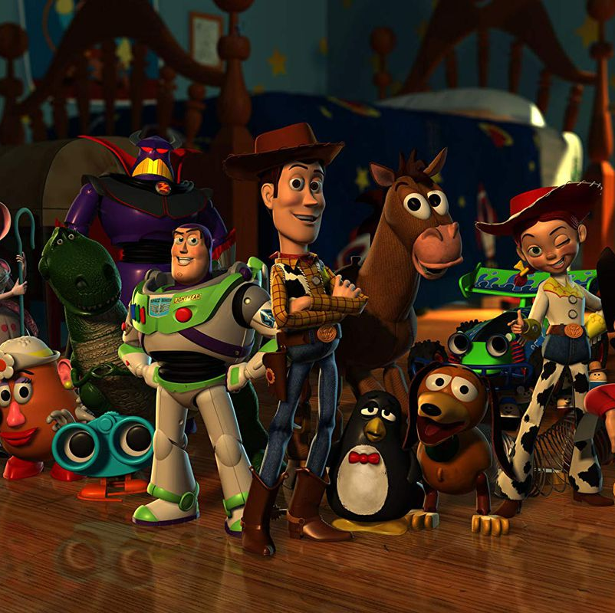
Symbolism in storytelling
Watch the following scene from Toy Story. Using all your knowledge of story structure, narrative expectations and colour theory from Unit 1, break down how the scene reveals character and plot through its actions and dialogue.
https://www.youtube.com/watch?v=RvO2Eg-rUG8

Slide 8
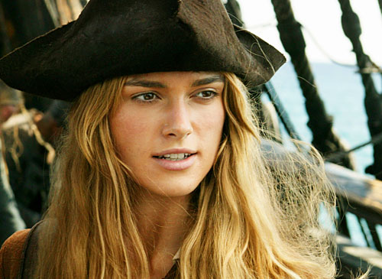
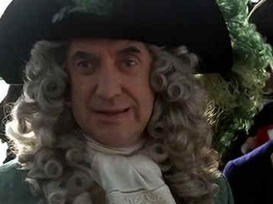
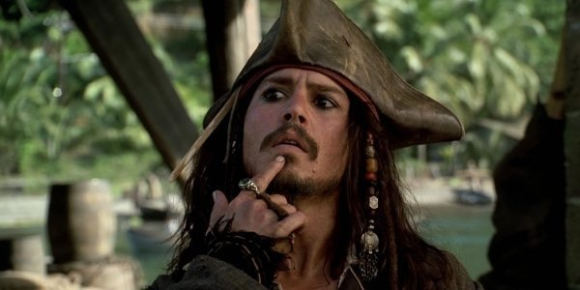
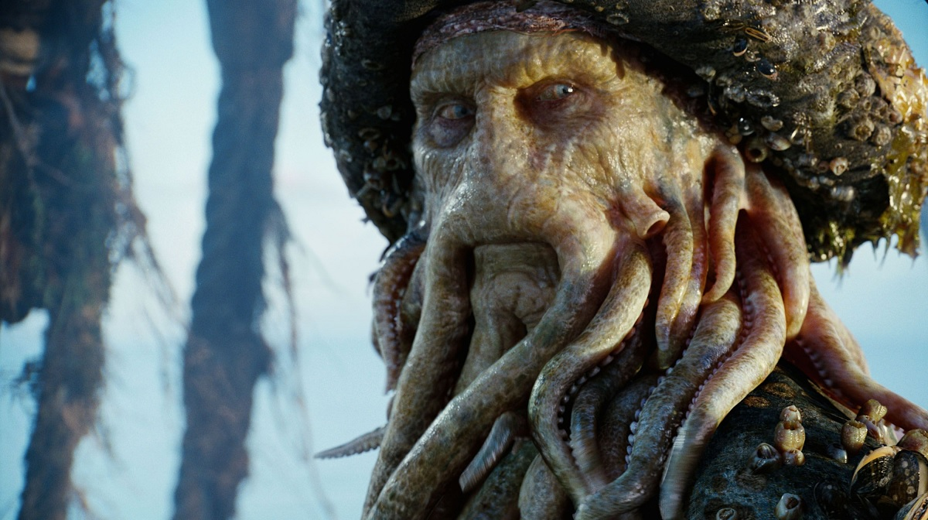
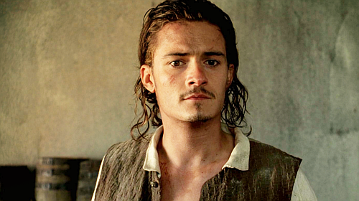
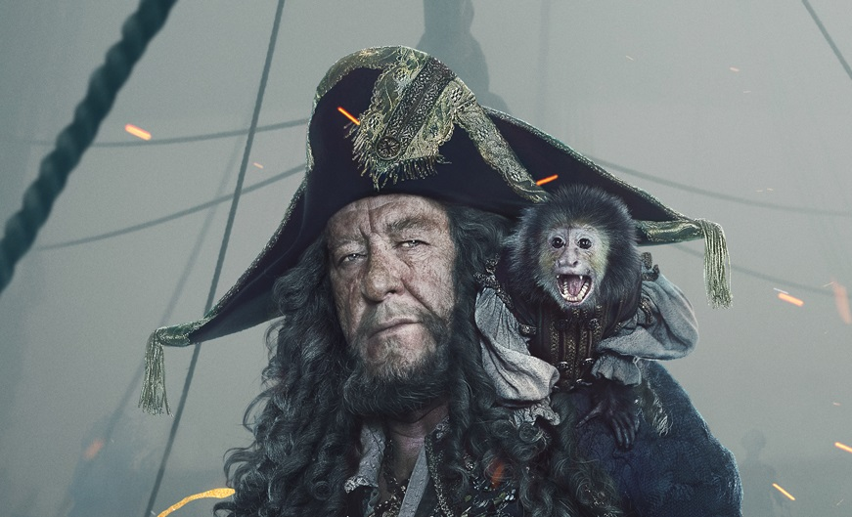
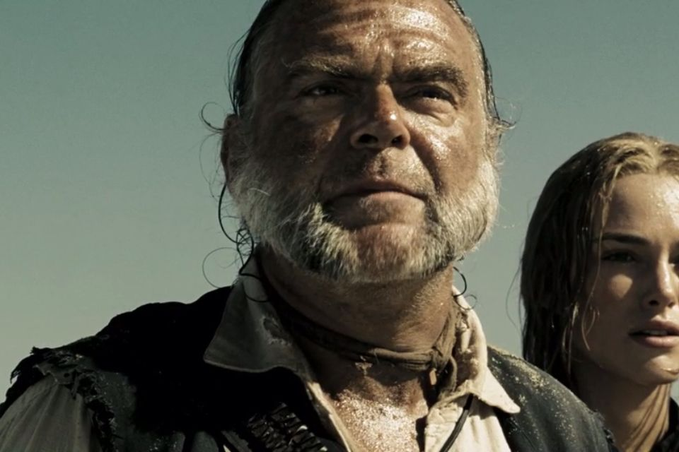
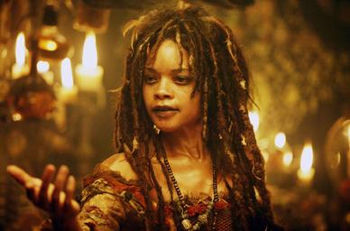
Propp’s Stock Characters
A guy called Vladimir Propp came up with a theory that all stories and all characters are basically the same. He believed that most characters in films fit into one of nine types, usually derived from archetypes. Archetypes are the first example of something: Satan might be the archetype villain, for example.
The Hero (Protagonist)
The Helper
The Villain (Antagonist)
The False Hero (Anti-Hero)
The Donor
The Dispatcher
The Princess
The Princess’ Father
See more here: http://changingminds.org/disciplines/storytelling/characters/propp_personae.htm

Slide 9
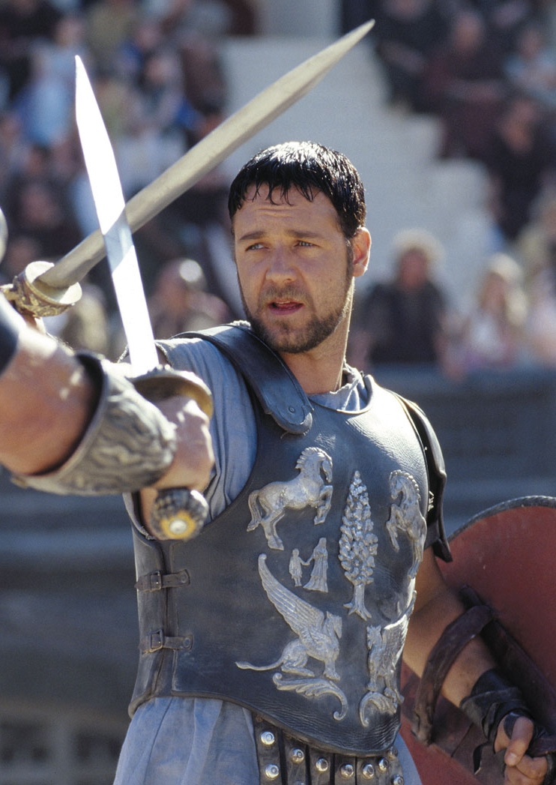
Homework reminder
Finish your Key Words Blog with the words from this week.
  Three Act Structure
  Inciting Incident
  Linear / Non-Linear Narrative
  Exposition
  Prologue / Epilogue
  Archetype
  Protagonist
  Antagonist
  Story arc
Two weeks ago, you wrote a small paragraph about how your favourite film plays with the expectations of its genre. You must now add two more paragraphs to this short essay. In the first paragraph, talk about the characters in the film and whether they fit with Propp’s Stock Character theory. In the second paragraph, talk about the overall narrative arc of the film. Does it follow a Three Act Structure? Upload your finished work to Wordpress and submit via Teams by Sunday 21st February 2021.

Slide 10
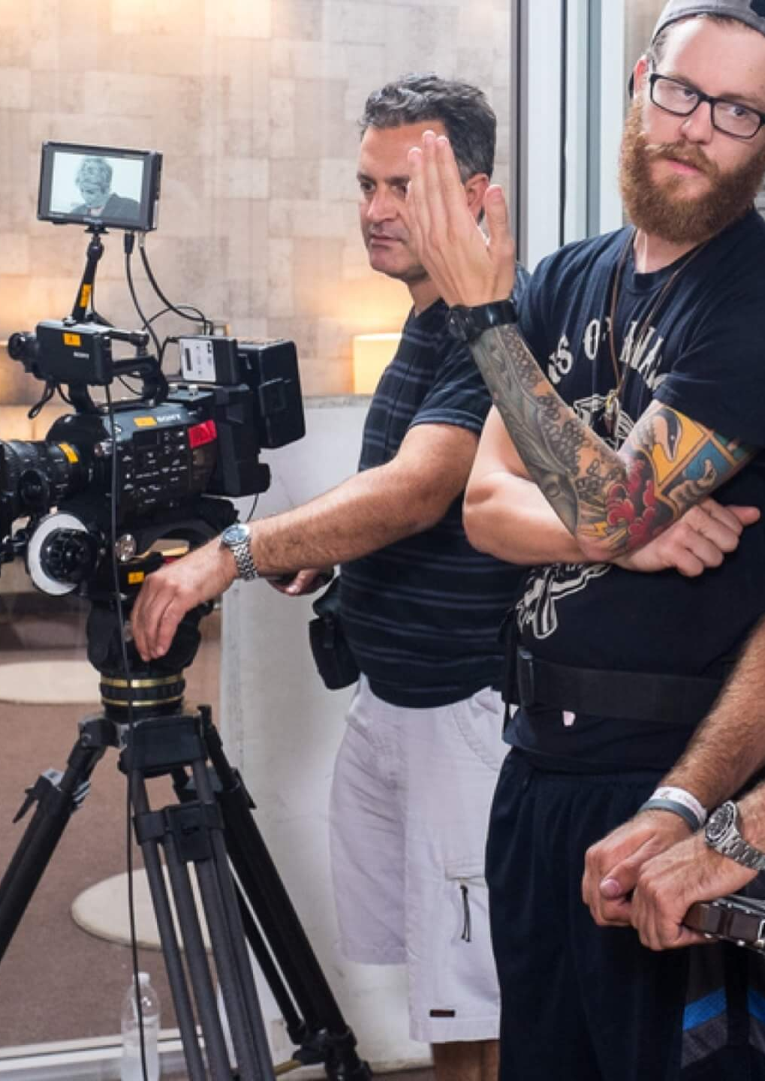
FMP PREP
FMP starts after half term.
10 weeks – Friday 14th May deadline
FMP running and being marked as usual BUT:
  More focus on prep and paperwork
  Less focus on practical
Why?
  UAL changes because of Covid
  Less likely to waste time / more likely to get a better grade
  Less margin for error.
Need to know:
  You will be given a job role
  Missing work = late start. Late start = low grade.

Slide 11
FMP PREVIEW

