Slide 1
Auteur and
Structure

Slide 2
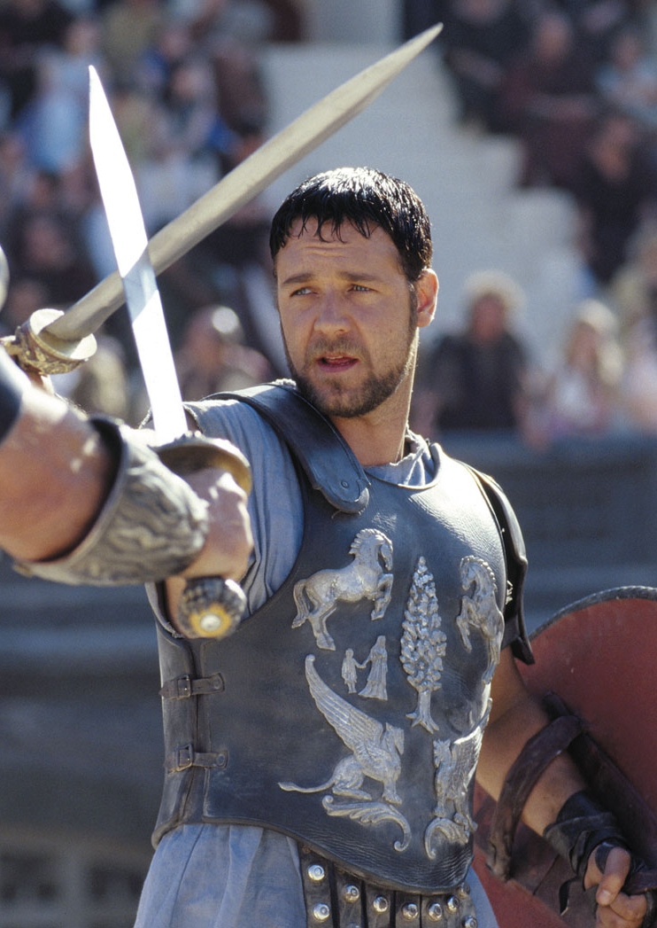
Homework reminder
Continue your Key Words Blog with the words from this week.
  Genre
  Sub-genre
  Trope
  Conform
  Subvert
Think of your favourite film. Write 400 words about how it subverts and conforms the expectations of its particular genre. Remember to include a reference to the film itself.
How Film Genres Have Changed Over Time: https://nofilmschool.com/Film-Genre-Popularity-Infographic

Slide 3
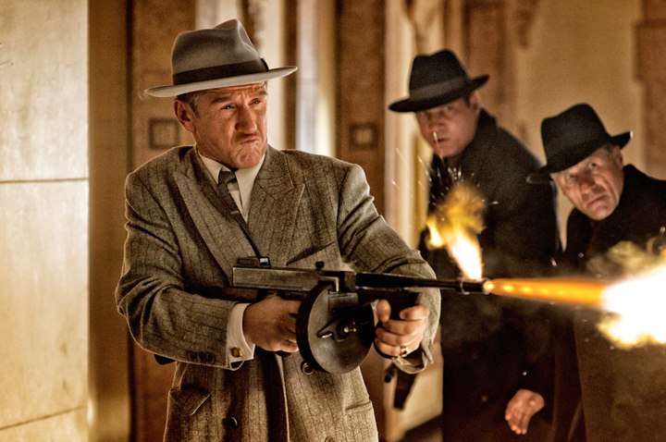


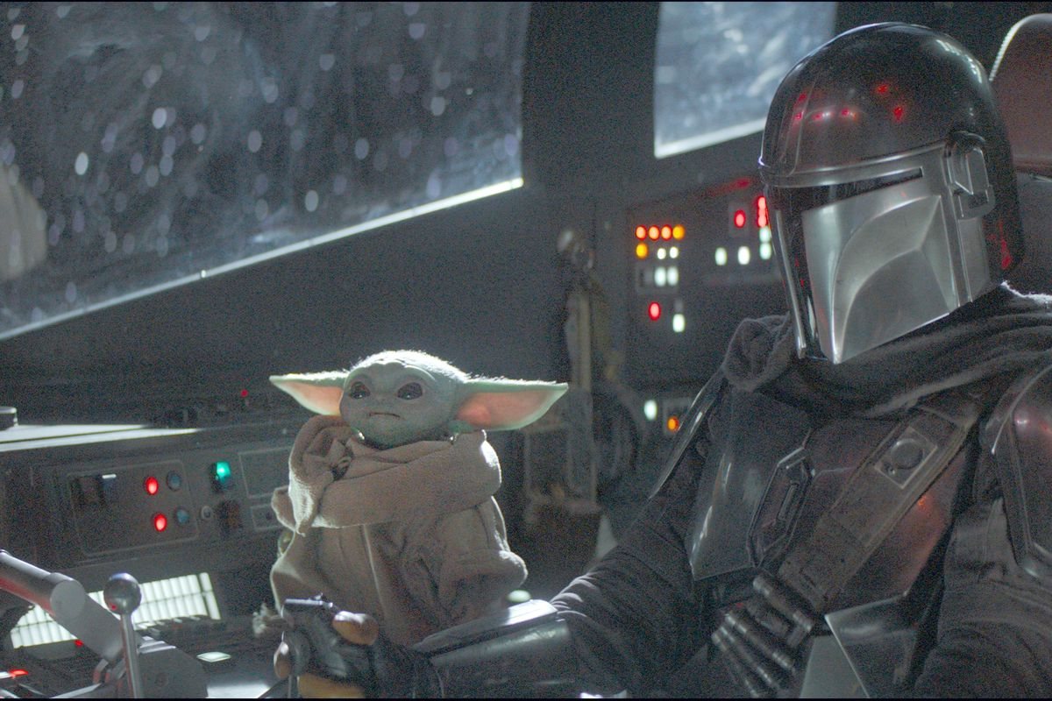


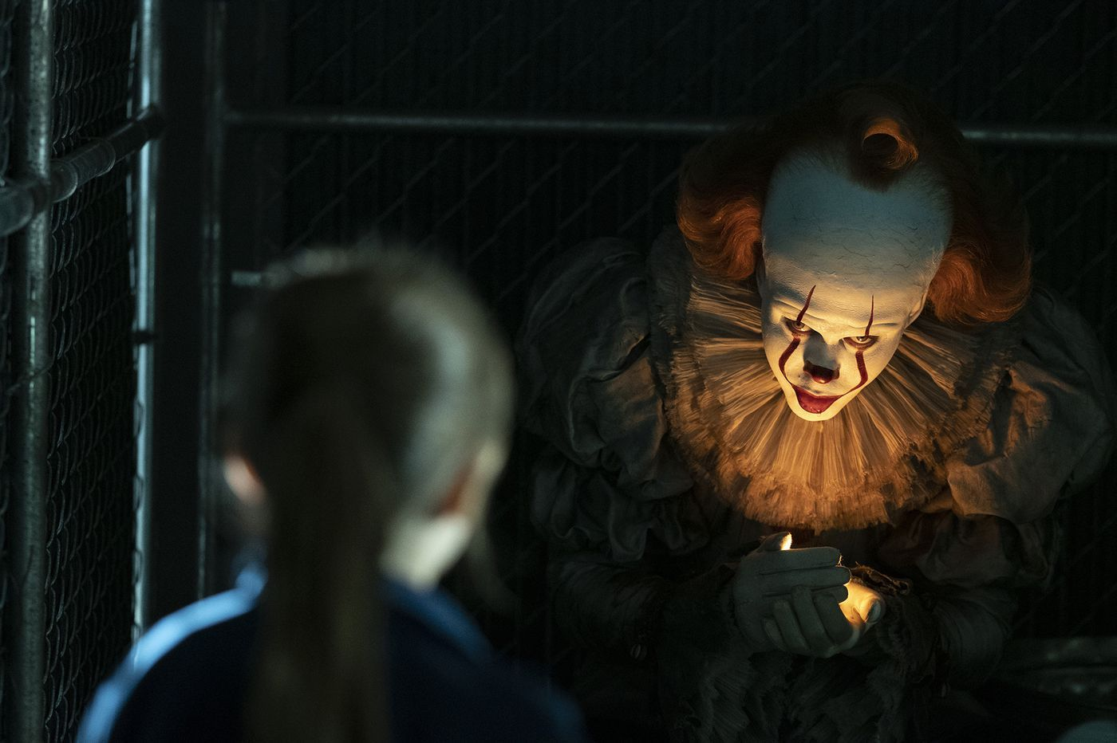


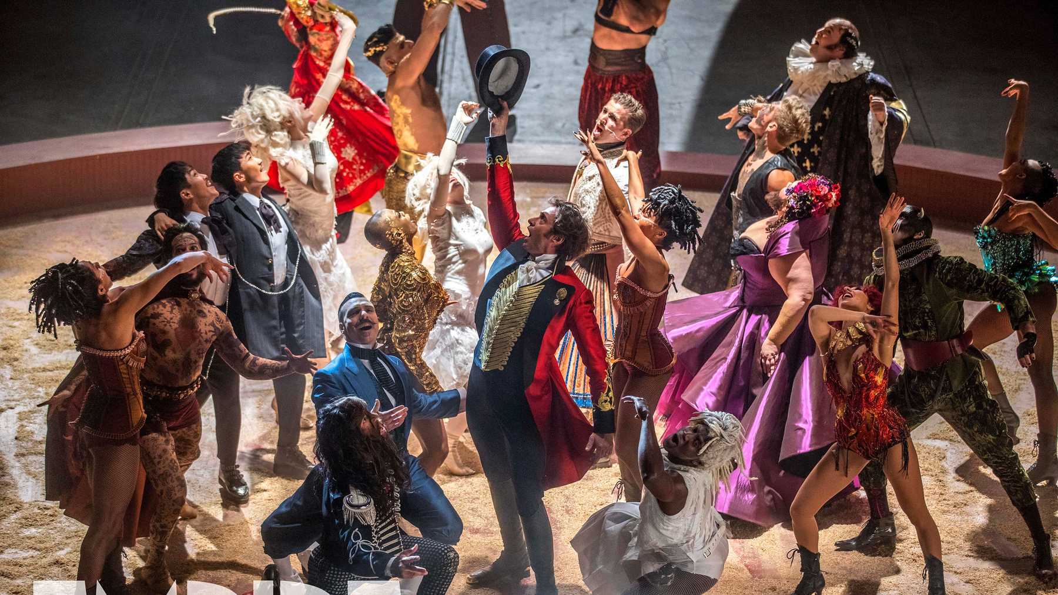
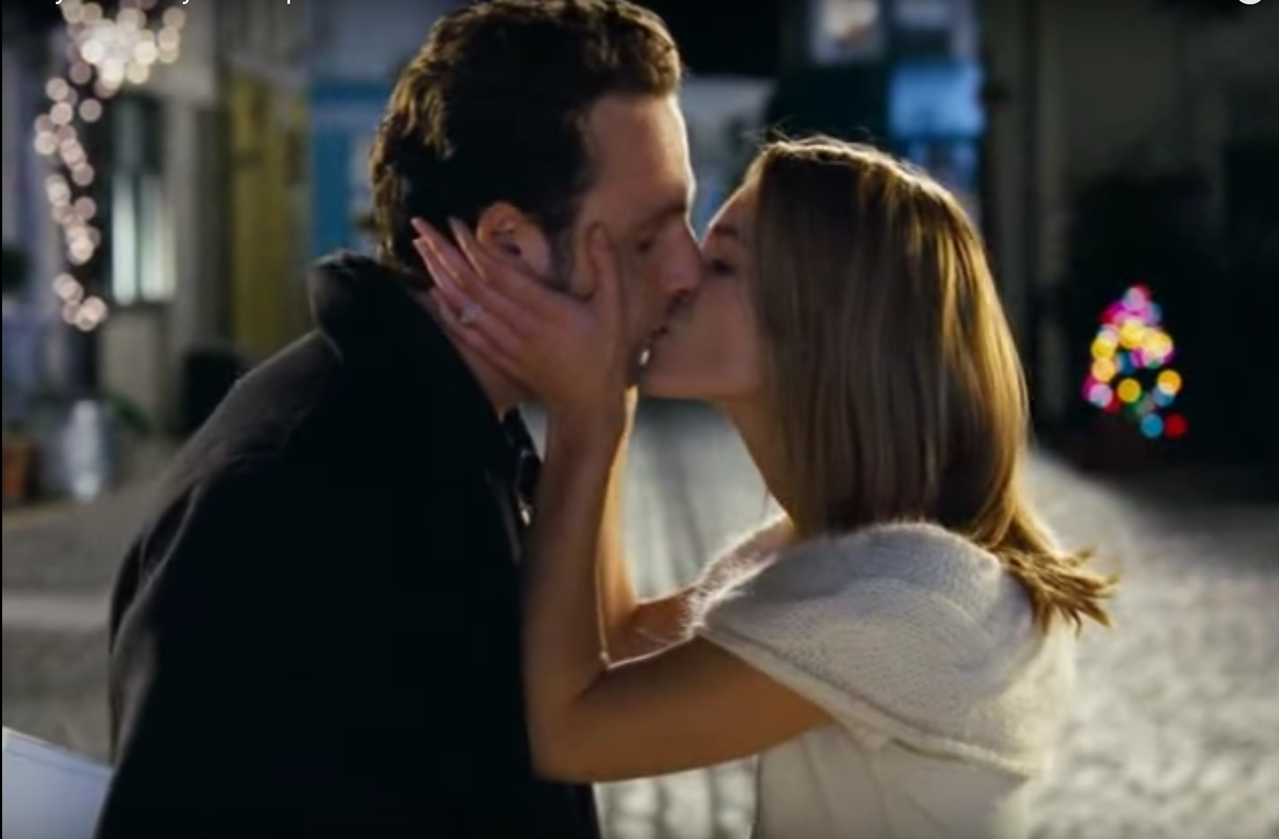
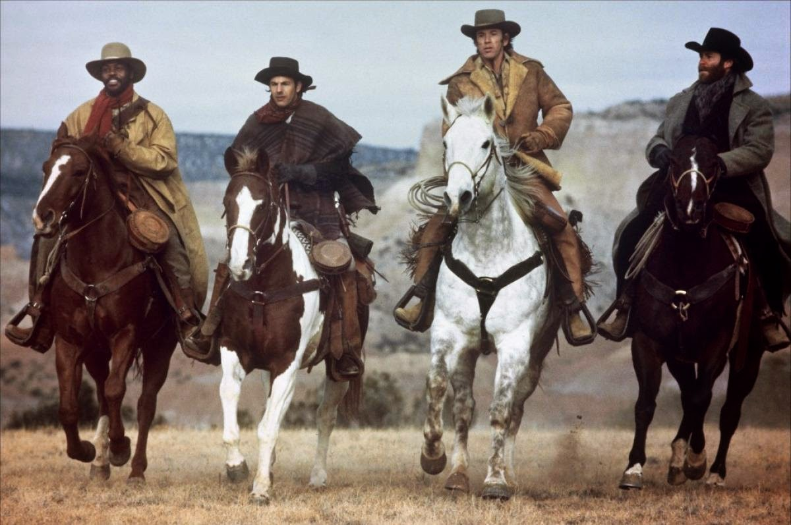
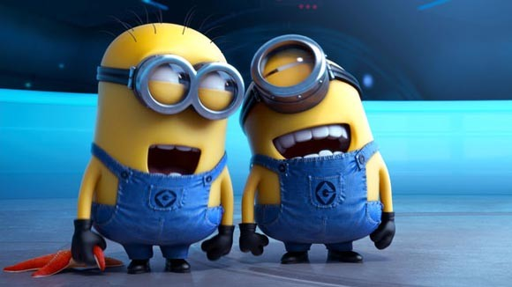
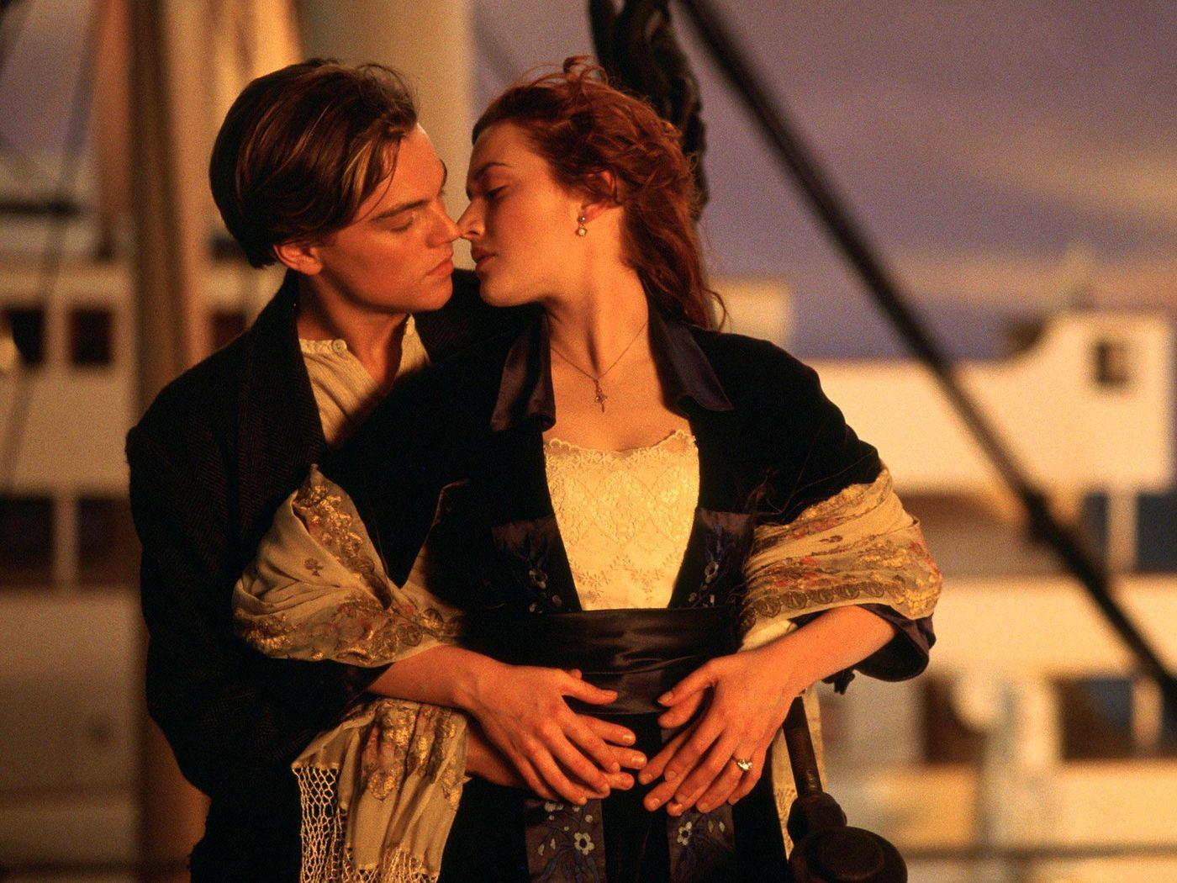
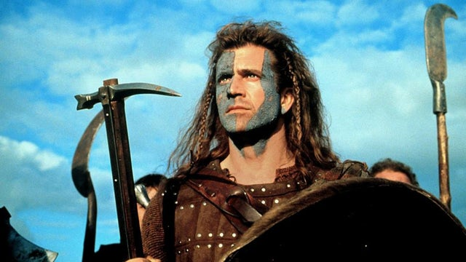
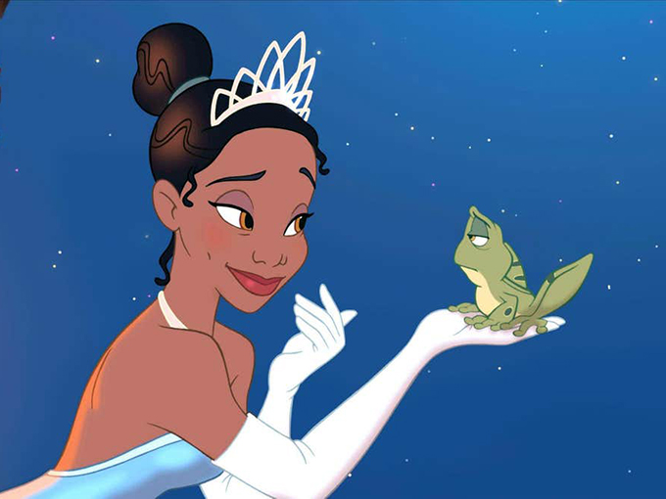
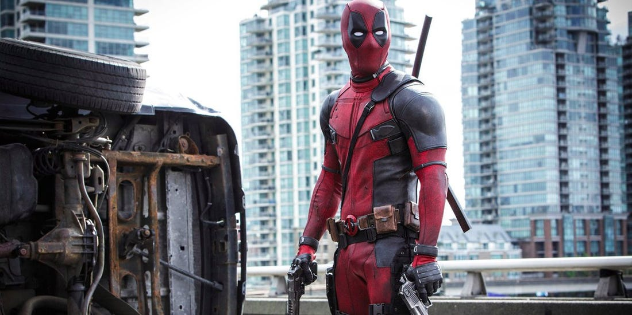
Mise-en-SCene
Mise-en-scene is the way in which the elements on screen (costume, setting, location, props, makeup) tell us something about the film. The mise-en-scene has been extensively thought about by the director and his team to give us clues about the world of the film.

Slide 4

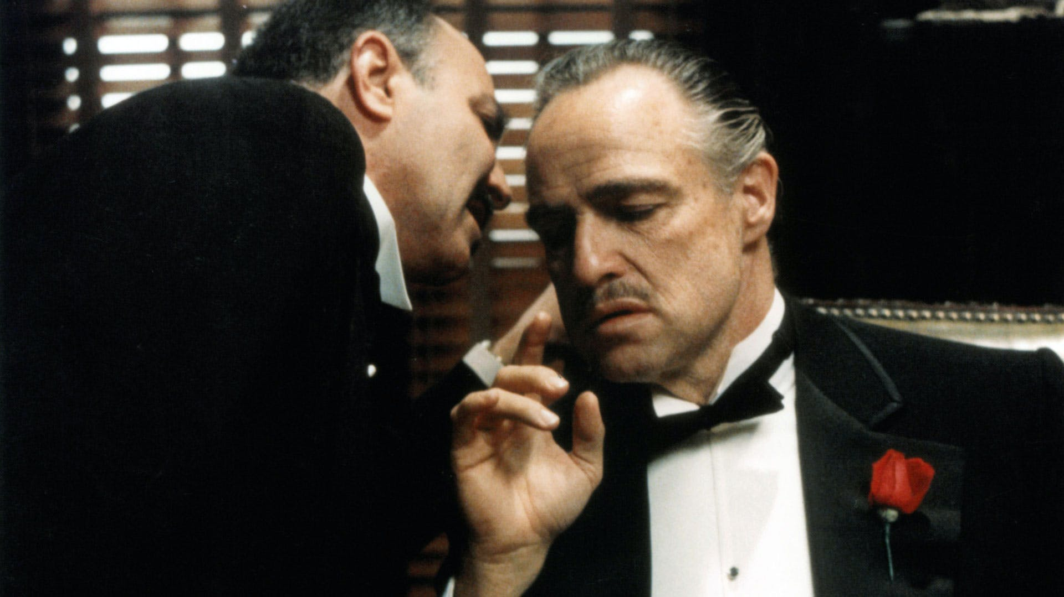
Example
Watch the clip from the film below. List as many examples of the mise-en-scene as you can think of. What are the signs that indicate the genre of the film?
  https://www.youtube.com/watch?v=ppjyB2MpxBU
  https://www.youtube.com/watch?v=SC4_ltUtdKI

Slide 5
What is Auteur Theory?
Auteur theory is the idea that the director of a film has a unique creative vision that is distinctly them. For example, you can probably picture what a Tim Burton film or a Tarantino film looks like because their style is so consistent from film to film.
https://www.youtube.com/watch?v=HcREWDplGBo
https://www.youtube.com/watch?v=O1-lkTgl-ws
https://www.youtube.com/watch?v=-1mAb2wXsRM
What are the similarities between the clips that let you know they were directed by the same person?
Do you believe Auteur theory a good or bad thing? What are some of the problems behind it?

Slide 6
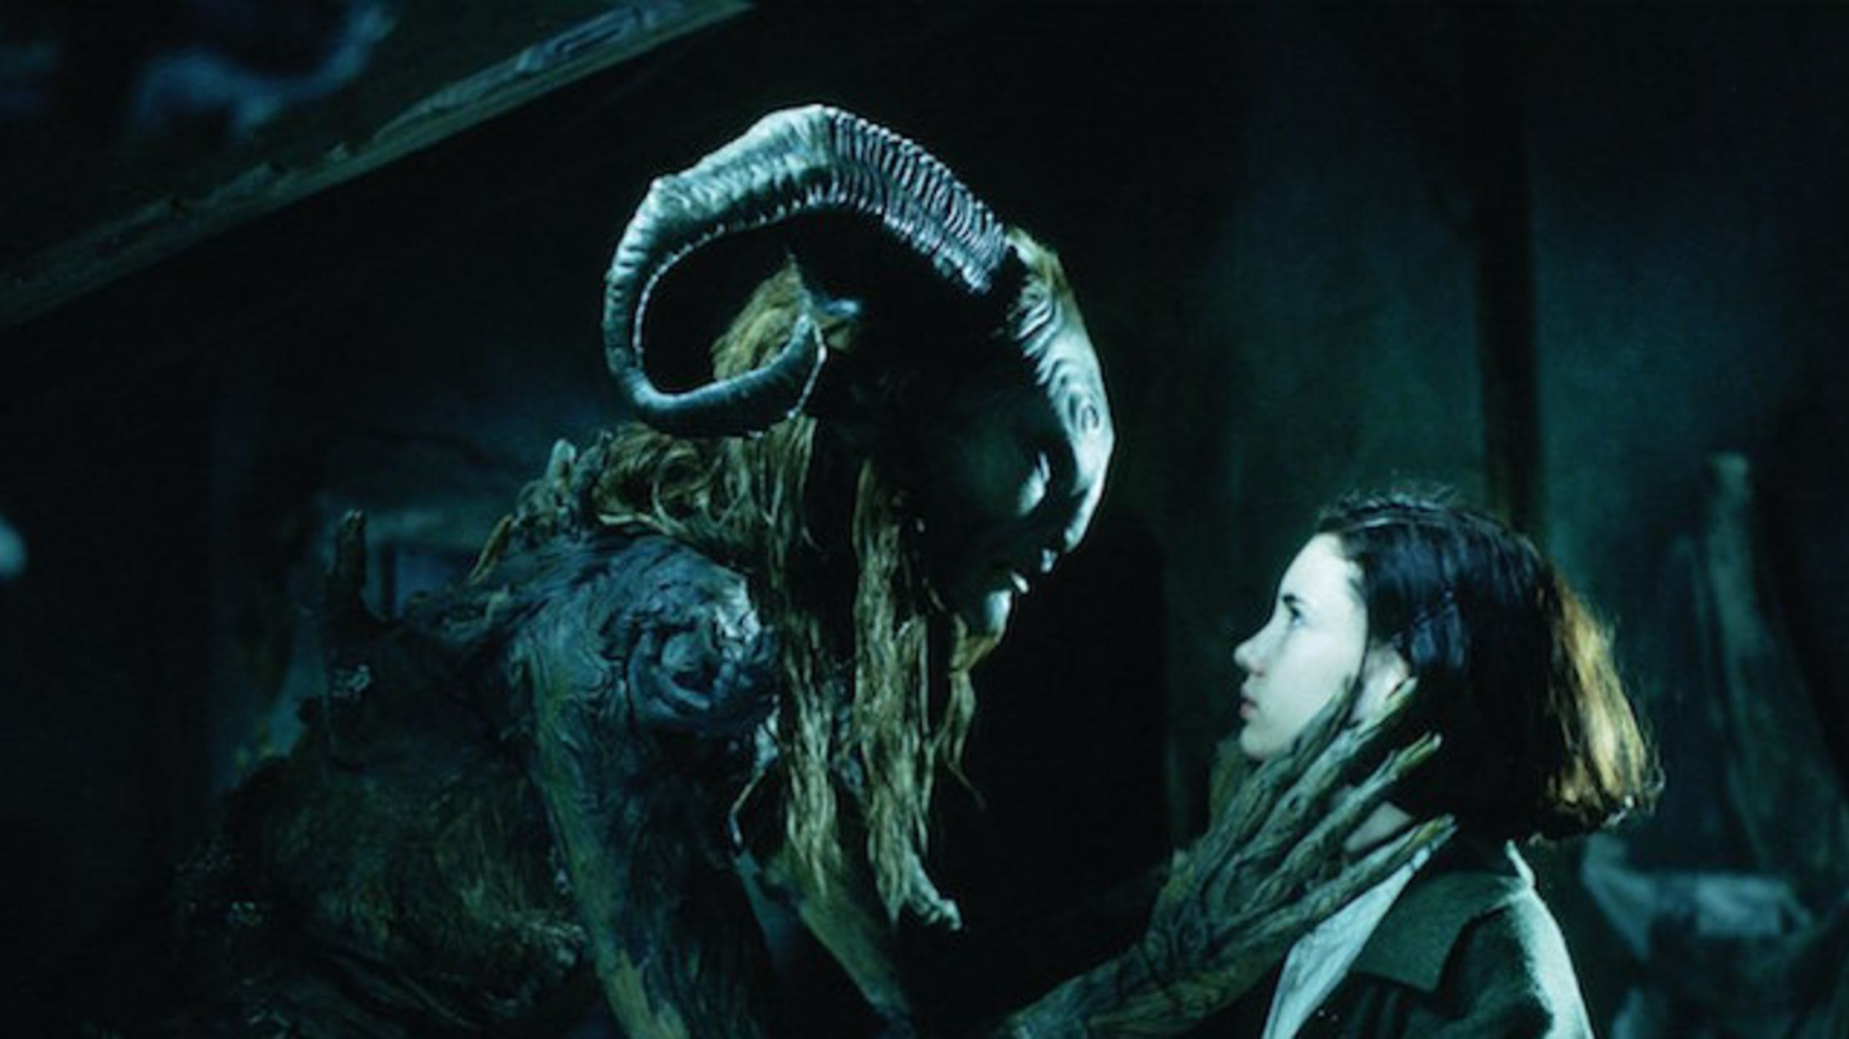
Critiques of genre
Watch from 46.16 – 1.02 of Pan’s Labyrinth. As you watch, make notes about genre, auteur theory and mise-en-scene. Think about:
The style
Use of colour
Themes
Genre tropes
Story structure
https://vimeo.com/504211111

Slide 7

Homework
Continue your Terminology Blog with the words from this week.
  Mise-en-scene
  Auteur theory
Watch an episode of Mark Kermode’s Secret of Cinema. Pick a genre of your choice. Summarise what you have learnt about the way the genre has developed over time and write 300 words on your blog, with examples.
https://www.bbc.co.uk/iplayer/episodes/b0bbn5pt/mark-kermodes-secrets-of-cinema

