Slide 1

Evaluation
Moving on – week 6

Slide 2
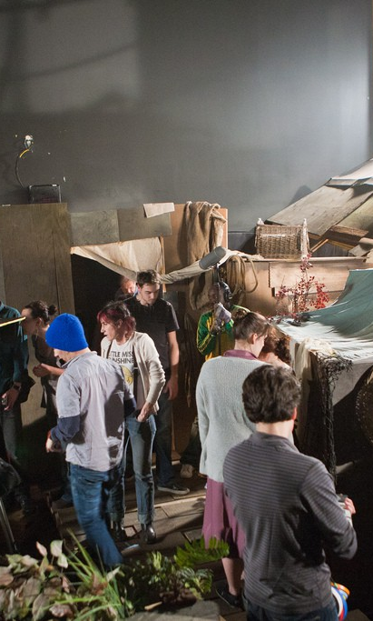
Homework REMINDER
Upload your finished Career Plan to your Wix/Wordpress site and submit via Teams by 12th February.
Complete the mock interview.

Slide 3
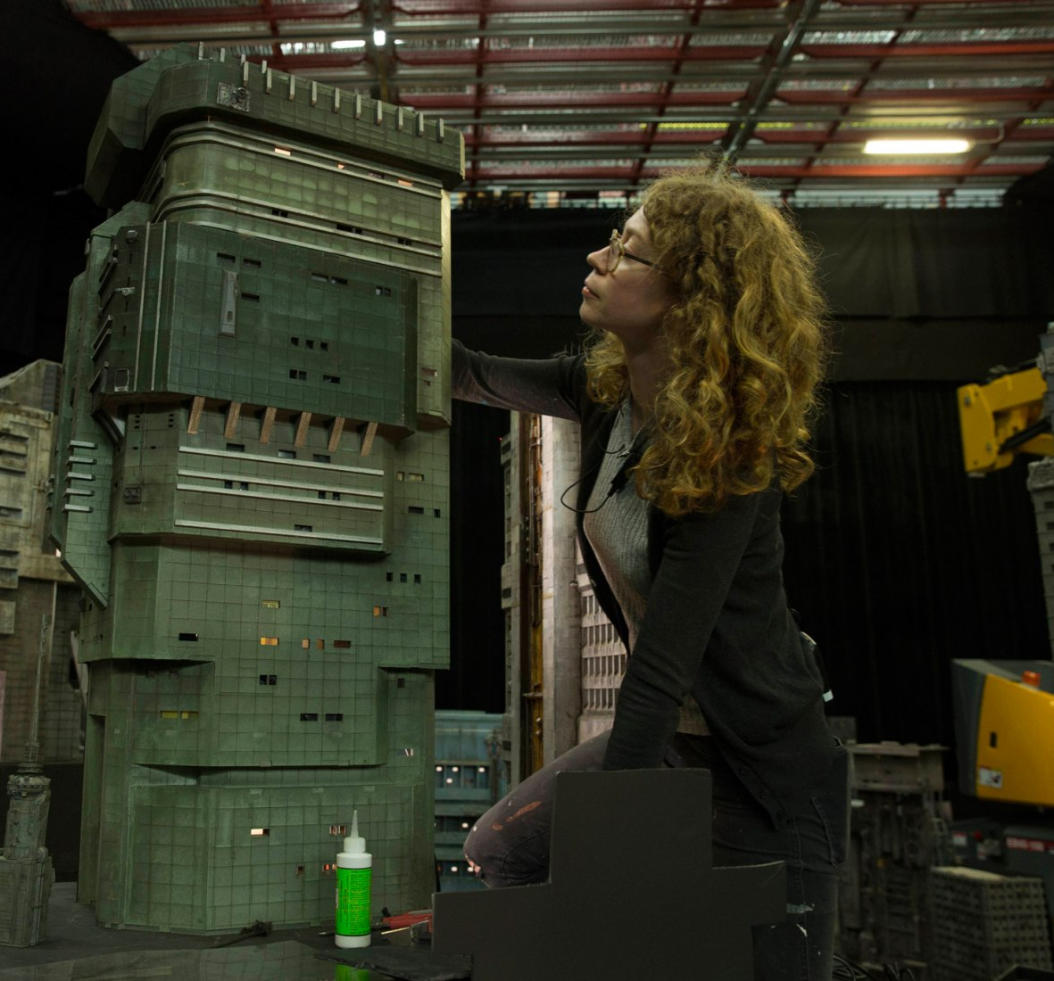
Today’s lesson
The purpose of reflection
Training / CV
FMP Prep
Unit summary

Slide 4
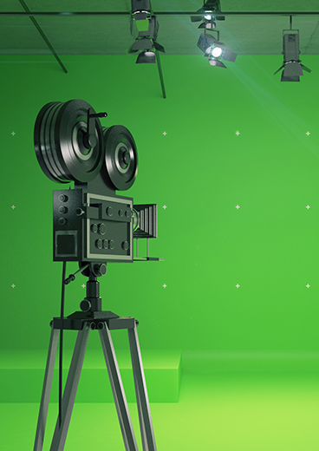
Evaluation
Now that you have completed your mock interview, you should spend some time reflecting on how it went.
Focus on:
  How prepared you were
  The quality of the answers you gave
  Your body language and manner
  Your nerves
  Your overall performance
On your Wordpress blog, write 400 words reflecting on your overall performance. How did you feel it went?
  You must set up to three targets for how you plan to improve in preparation for your next interview.
Additional:
Screenskills training – give another look
CV prep

Slide 5
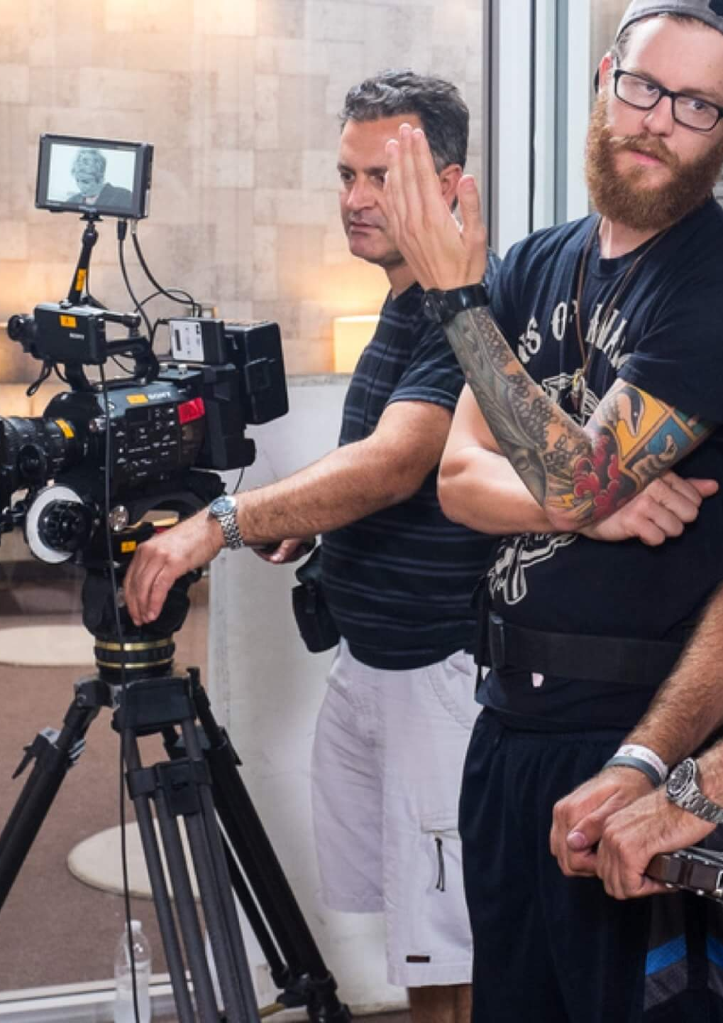
FMP PREP
FMP starts after half term.
10 weeks – Friday 14th May deadline
FMP running and being marked as usual BUT:
  More focus on prep and paperwork
  Less focus on practical
Why?
  UAL changes because of Covid
  Less likely to waste time / more likely to get a better grade
  Less margin for error.

Slide 6
The marking system
You take home your highest grade at FMP. You are marked against seven criteria. If, for example, six criteria are marked Distinction and one is marked Pass, your final grade will be a PASS.
How?
This is why it’s particularly important to work consistently across the 10 weeks of the unit and to address any weak areas before you start.
CONTEXT
PLANNING
RESEARCH
PROBLEM SOLVING
PRACTICAL SKILLS
EVALUATION + REFLECTION
PRESENTATION

Slide 7
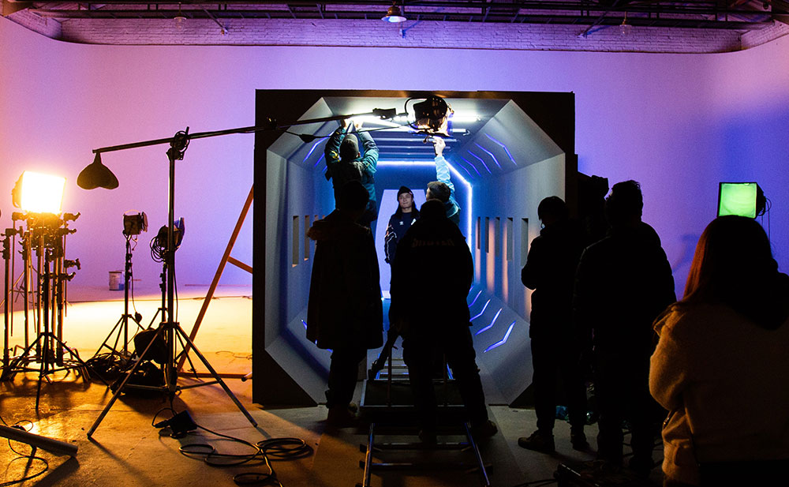
Job Roles
You will be working towards the creation of a film. You will be given one of the below roles – this is the position you will be marked on throughout the FMP.
Cinematographer
Key Grip / Colourist
Casting Director / Assistant Director
Camera Operator
Behind-the-scenes
Stills Photographer
Marketing Manager
Sound Recordist / ADR Recordist
Boom Operator / Sound Mixer
Script Supervisor / Post-Production Supervisor
Gaffer
Editor
Production Designer

Slide 8

Targets Re-visited
At the start of this unit, you set three targets for yourself based on the performance of your Documentary.
  TASK: revisit those targets now at the end of the unit. Did you meet them? How can you improve?
  Adjust or change your targets now – what can you do to be best prepared for your FMP?

Slide 9
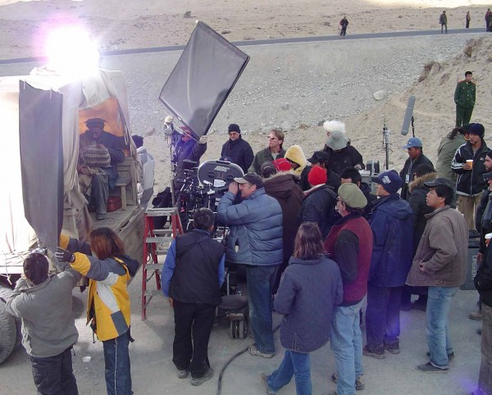
Homework
Opportunities
Complete your 400 word evaluation, reflecting on your mock interview performance and setting up to three targets to work on.
Complete your Career Plan and upload to Teams before 12th Feb: tomorrow!

Slide 10

UNIT CHECKLIST
Completed Career Plan
Completed Showreel and / or Portfolio
Completed Mock Job interview
400-word reflection on how your mock interview went
UNIT DEADLINE: Sunday 21st February 2021.
Work to be submitted: via Microsoft Teams.
How? Submit link to your Wordpress blog page for this unit.

