Slide 1

INTERVIEW SUCCESS
Getting the JOB – week 5

Slide 2
Homework reminder
Complete your career plan using the template on the course website. You may use this to identify opportunities to apply for – go for it!

Slide 3
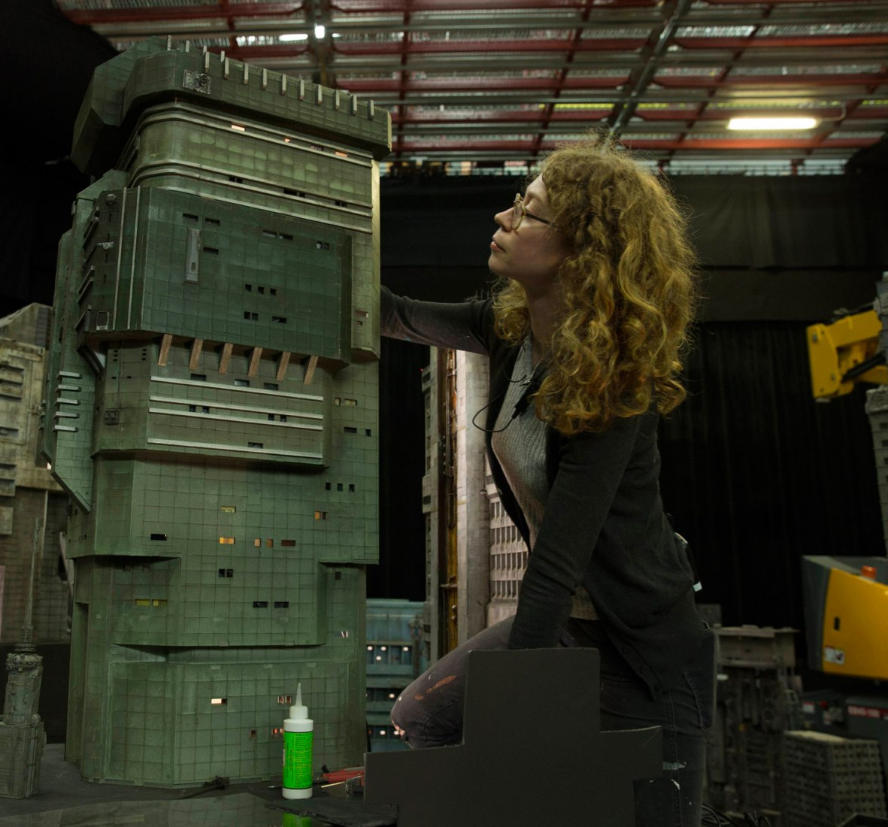
Today’s lesson
Making a good impression
Knowing what helps you stand out
Where to look for jobs
Preparation for interview

Slide 4
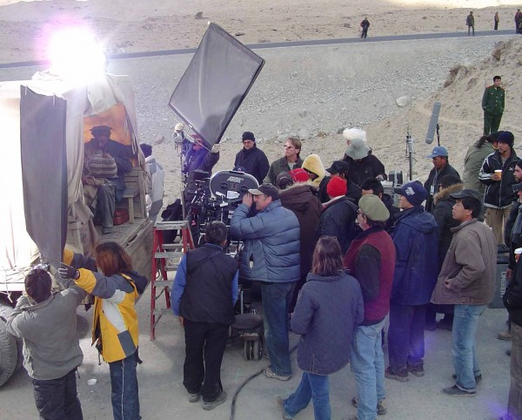
Creative Access
Opportunities
A job, funding and opportunities site specifically providing opportunities for those with talent who may come from an under-represented background.
https://creativeaccess.org.uk

Slide 5
Interview Tips
The Benefits
Increasing your earnings potential significantly
Opening up your professional contacts
Demonstrating a commitment to your own development
Growing up: moving home, managing money
‘Free’ access to kit and facilities
Three more years to mess things up
Opening up more doors for the future
Lot of support for those most deserving
Watch the clip below for some really helpful top tips on your upcoming university interviews. It is likely that your interviews will take place on Zoom, but the same general ideas still apply.
  https://www.youtube.com/watch?v=YgVjgGz7FDc
‘Tell me about yourself.’
  Passion
  Results
  Direction
Are you excited about something? Are you driven to do the best for yourself?

Slide 6

Interview - Advanced
A job interview is stressful and pressurised. But it doesn’t have to be difficult. The key is to be prepared, be confident and be yourself. Remember, the interview panel want you to be good!
Do your research on the company.
Don’t be put off by them making notes.
Be polite – thank them for their time. Try and remember their names if you can.
Be honest – including if you don’t know.
Don’t rush into any old rubbish, take time and give a good answer.
Get the tone right – don’t swear or use language which isn’t appropriate for a job interview.
Try not to just repeat what’s already on your application.
Remember what they’re looking for. Make it easy for them.
Fun fact – interviews aren’t like this! People want you to do well, no matter how scary it may feel.

Slide 7

Mock Interview
You will conduct a mock job interview for this unit. This is designed to help prepare you for your upcoming interviews – and although it is nerve wracking, practice will help to improve your performance and allow you to deal with the nerves.
Useful places for research:
  https://www.linkedin.com/learning/jodi-glickman-on-pitching-yourself/lead-with-your-destination
  https://www.channel4.com/programmes/the-job-interview

Slide 8
The Mock Interview
What?
You will conduct a mock job interview online. It will be recorded and not with a live panel. You will be asked questions and given time to answer.
How?
You should dress smart and conduct the interview as if it was real. This is to help prepare you for the real thing, and the feedback will help to make you better prepared for your uni interviews.
When?
You will be able to do the interview at a time of your choosing over the next week.
Why?
This is a required part of this unit. Not having a live panel means that you can remove one level of stress and focus instead on giving good answers to the questions.

Slide 9

The Mock Interview
Access the mock interview here: https://app.willotalent.com/invite/davXDk/
This must be completed before Thursday 11th February 2021.
Make sure you are prepared before you begin as you can’t re-start or try again.
What Job?
  The questions are generic, so you should answer them based on the job/uni/apprenticeship you ideally want to apply for. Even more reason to do your research before you begin.

Slide 10
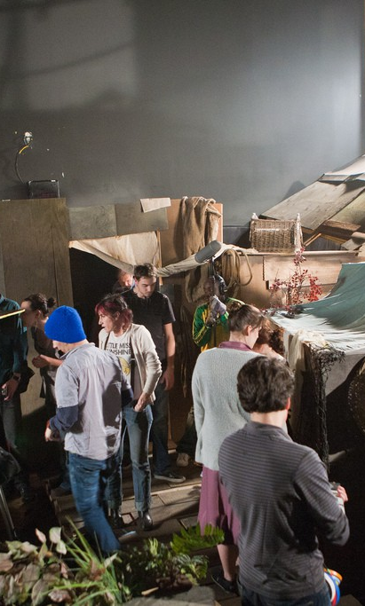
Homework
Upload your finished Career Plan to your Wix/Wordpress site and submit via Teams.
Complete the mock interview and answer the questions before next week’s session.

