Slide 1
Quoting and referencing

Slide 2
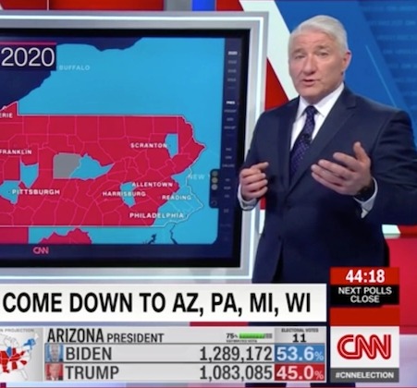
Homework reminder
Continue your Key Words Blog with the words from this week.
  Anchor
  Left Wing / Right Wing
  Vox Pop
  Product Placement
  Quantitative
  Qualitative
  Secondary
  Primary
Watch the documentary Outfoxed and make notes in preparation for next week’s lecture. You can watch the documentary here: https://www.youtube.com/watch?v=P74oHhU5MDk&t=2480s

Slide 3
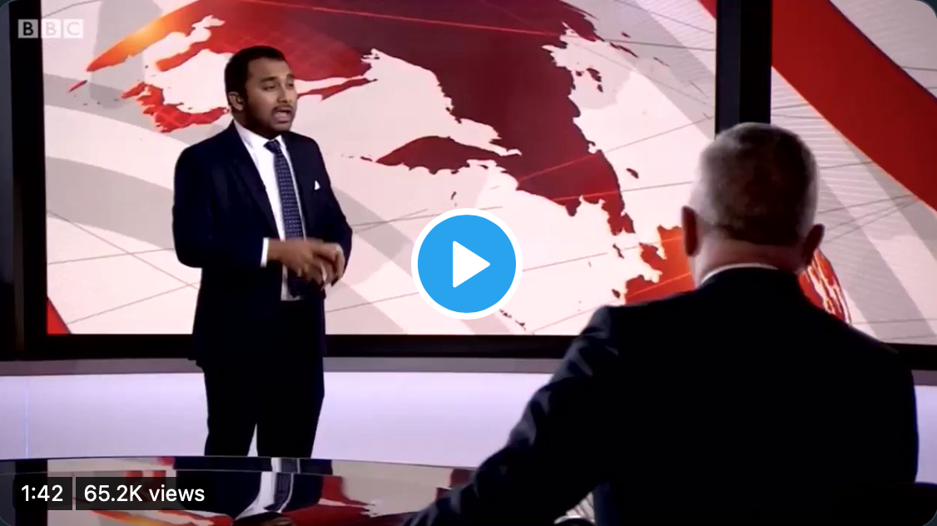
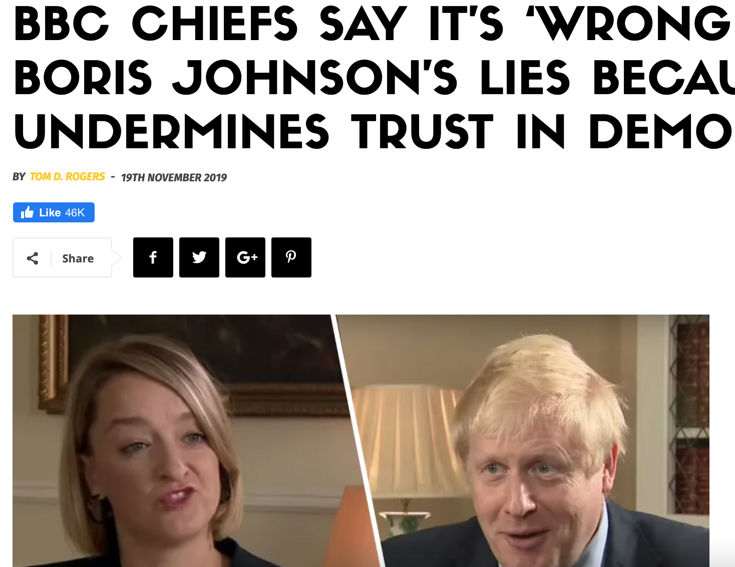
The WEEK in media…

Slide 4
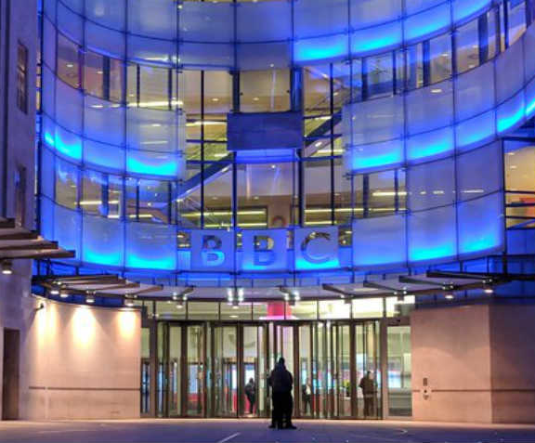
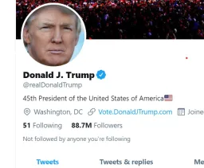
Conducting Research
Work through the short questionnaire and complete the answers, after looking at the two articles on the previous page.
The results of the survey I have just asked you to complete mean that I have now conducted some primary research. I have collected both qualitative and quantitative data.

Slide 5

Quoting and referencing
Quote
For example: Discussing the BBC license fee, the director general said, ‘it’s impossible for us to be impartial all the time.’
Similar to a quote, a reference is acknowledging that you have got information from somewhere else. This shows that you have used somebody else’s work and acknowledges where you got it from: eg, from a website or a book.
For example: The BBC is supposed to be impartial. Joe Bloggs, in his book, Public Service Broadcasting, describes, ‘the BBC comes under a lot of flack, but it is essential that we keep it,’ whereas Nigel Farage on his LBC show (16th February 2020) described the license fee as, ‘the biggest waste of money in this country’s history.’
A list of the places you got information from in an essay etc. This is normally presented at the end of an essay, arranged alphabetically by the author surname.
You don’t need to remember how to reference everything: these websites help:
https://www.citethemrightonline.com
Reference
Bibliography
Help

Slide 6
bibliography
Axlerod, Brian, British TV News: A Brief History (Penguin, London, 1998)
Castle, Chris, ‘Sky sports is the best thing to happen since sliced bread,’ The Sun, 14th February 2012 [https://l3media.home.blog/inside-media/] <Accessed 16th February 2020]
Coyle, Danny, Jobs in Television (Oxford University Press, Oxford, 2002)
Rajan, Amol, ‘Who is Richard Sharp, the BBC’s new chairman?’ BBC News, <https://www.bbc.co.uk/news/entertainment-arts-55561667> [Accessed 16th February 2020].

Slide 7
plagiarism
Plagiarism is copying someone else’s work without acknowledging that it isn’t yours. It’s a bit like downloading a clip from Youtube and pretending it’s your own film. Plagiarism is banned by college as it is a form of cheating and can even result in legal action. This is why referencing your work effectively is essential.
Your submissions in college go through a piece of software called TurnItIn which compares your work and scans it for signs of plagiarism.

Slide 8
News uk tv - Assignment
Marked Assignment
Last week you were asked to watch Outfoxed, the expose documentary about Fox TV, ran by Rupert Murdoch
Rupert Murdoch operates what is known as a monopoly – giving him a huge control over the world’s media. The whole of the UK newspaper landscape is owned by 5 billionaires.
Rupert Murdoch is about to launch a new TV channel in the UK. You must write 500 words giving your thoughts on whether you think this is a good idea or not. Although this is an opinion, you must back up your argument with facts. You need to include at least one quote, and references from at least two different sources. You should include a bibliography. Deadline for this to be submitted and marked is Monday 25th January 2021.
Some suggested places to research are below (you don’t have to use these):
https://www.theguardian.com/media/2020/dec/01/rupert-murdochs-news-uk-tv-channel-given-approval-to-launch
https://www.bbc.co.uk/iplayer/episodes/m000kxw1/the-rise-of-the-murdoch-dynasty
https://www.youtube.com/watch?v=P74oHhU5MDk&t=2483s
https://www.youtube.com/watch?v=M8fFOFZAkjU

Slide 9
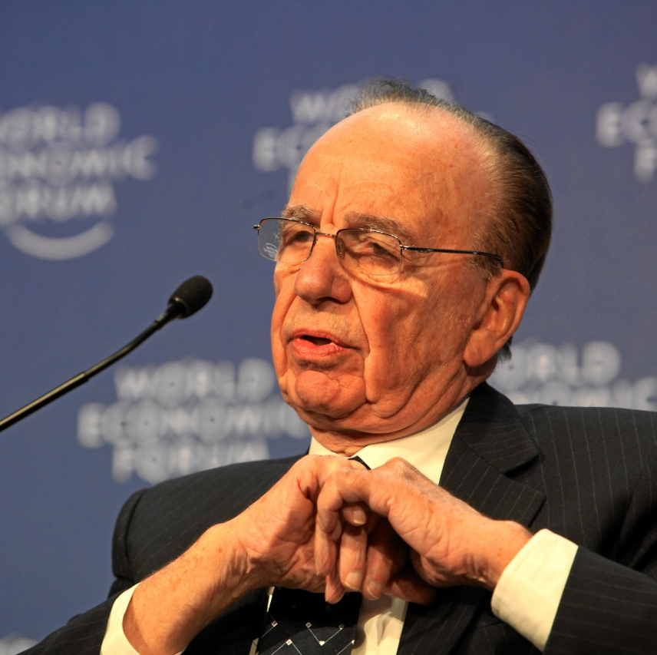
Homework
Continue your Terminology Blog with the words from this week.
  Plagiarism
  Reference
  Quote
  Bibliography
  Monopoly
Complete the 500 word written assignment and submit via Teams for next week.
DEADLINE 25th JANUARY 2021

