Slide 1
GENRE
Film types and styles

Slide 2

Homework reminder
Continue your Terminology Blog with the words from this week.
  Plagiarism
  Reference
  Quote
  Bibliography
  Monopoly
Complete the 500 word written assignment and submit via Teams for next week.
DEADLINE 25th JANUARY 2021

Slide 3
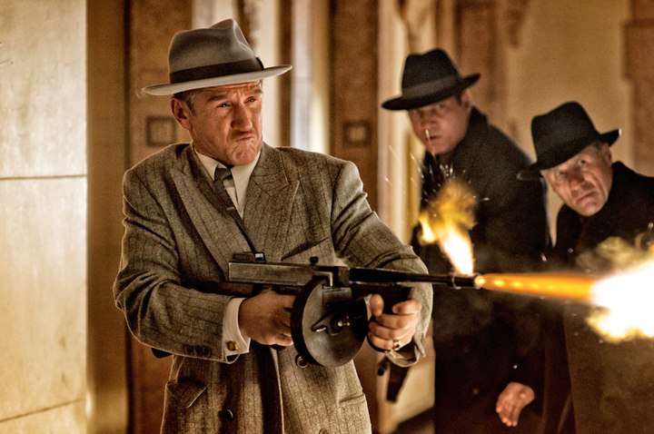


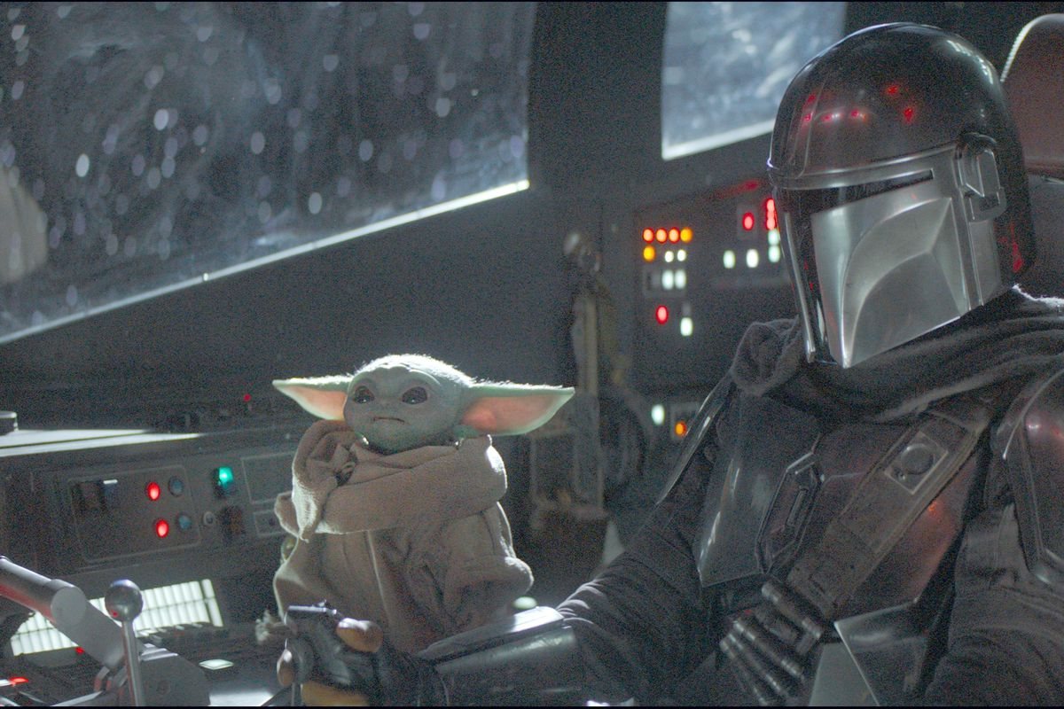


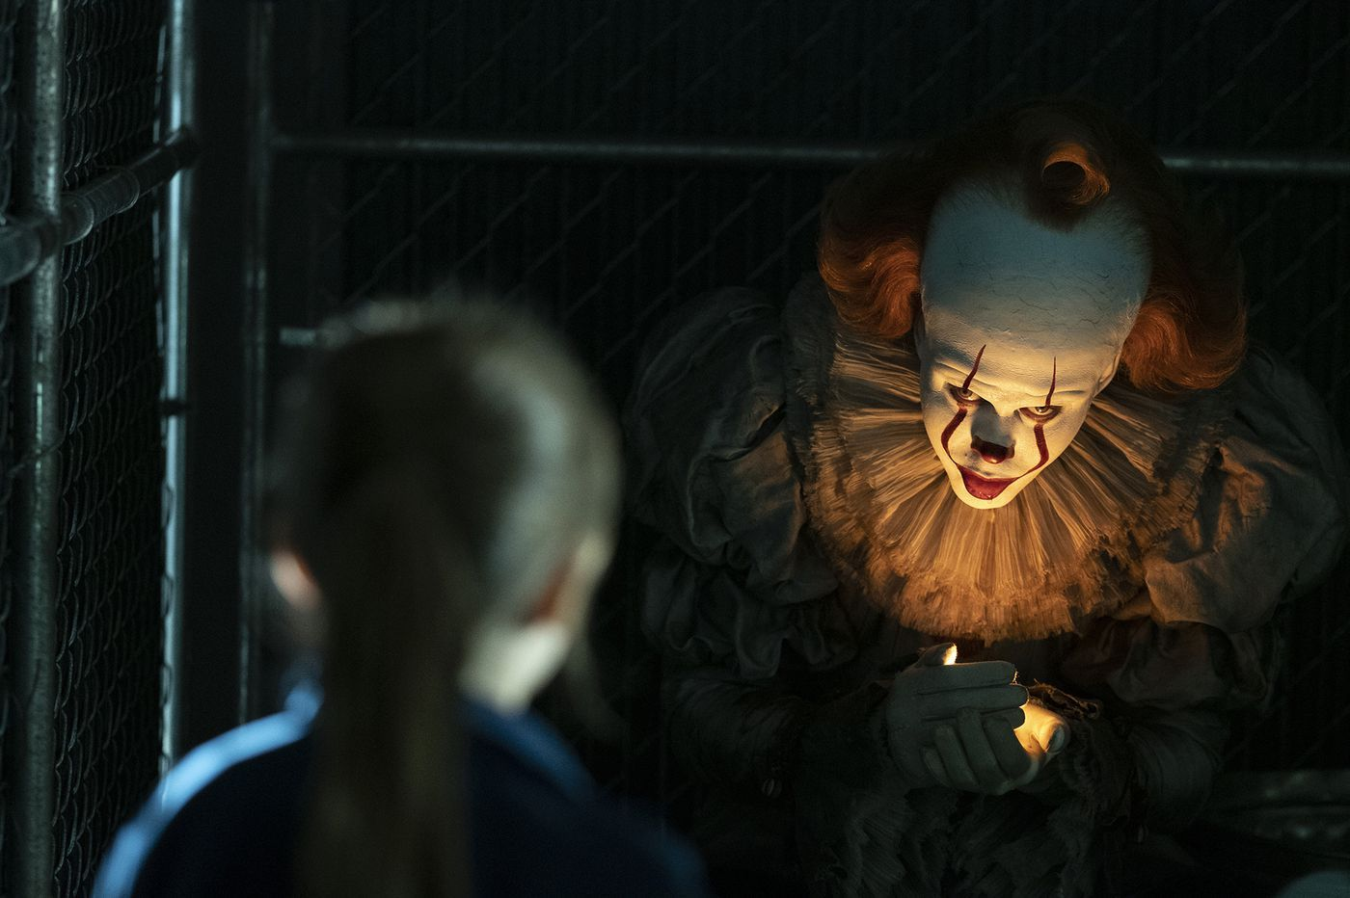


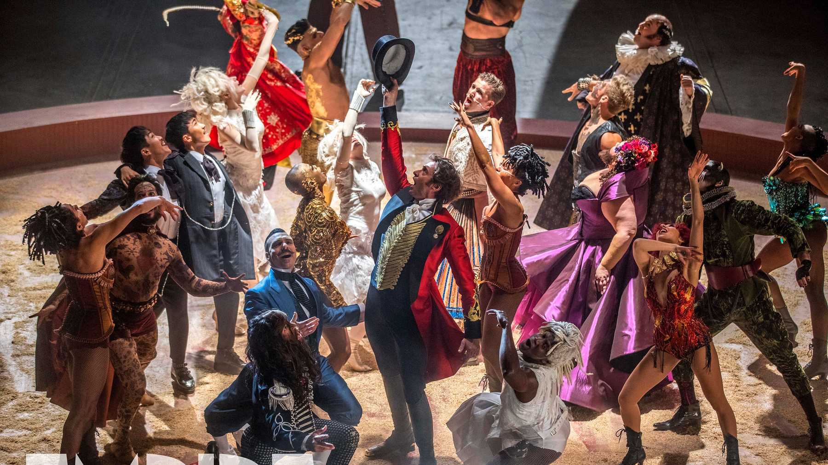
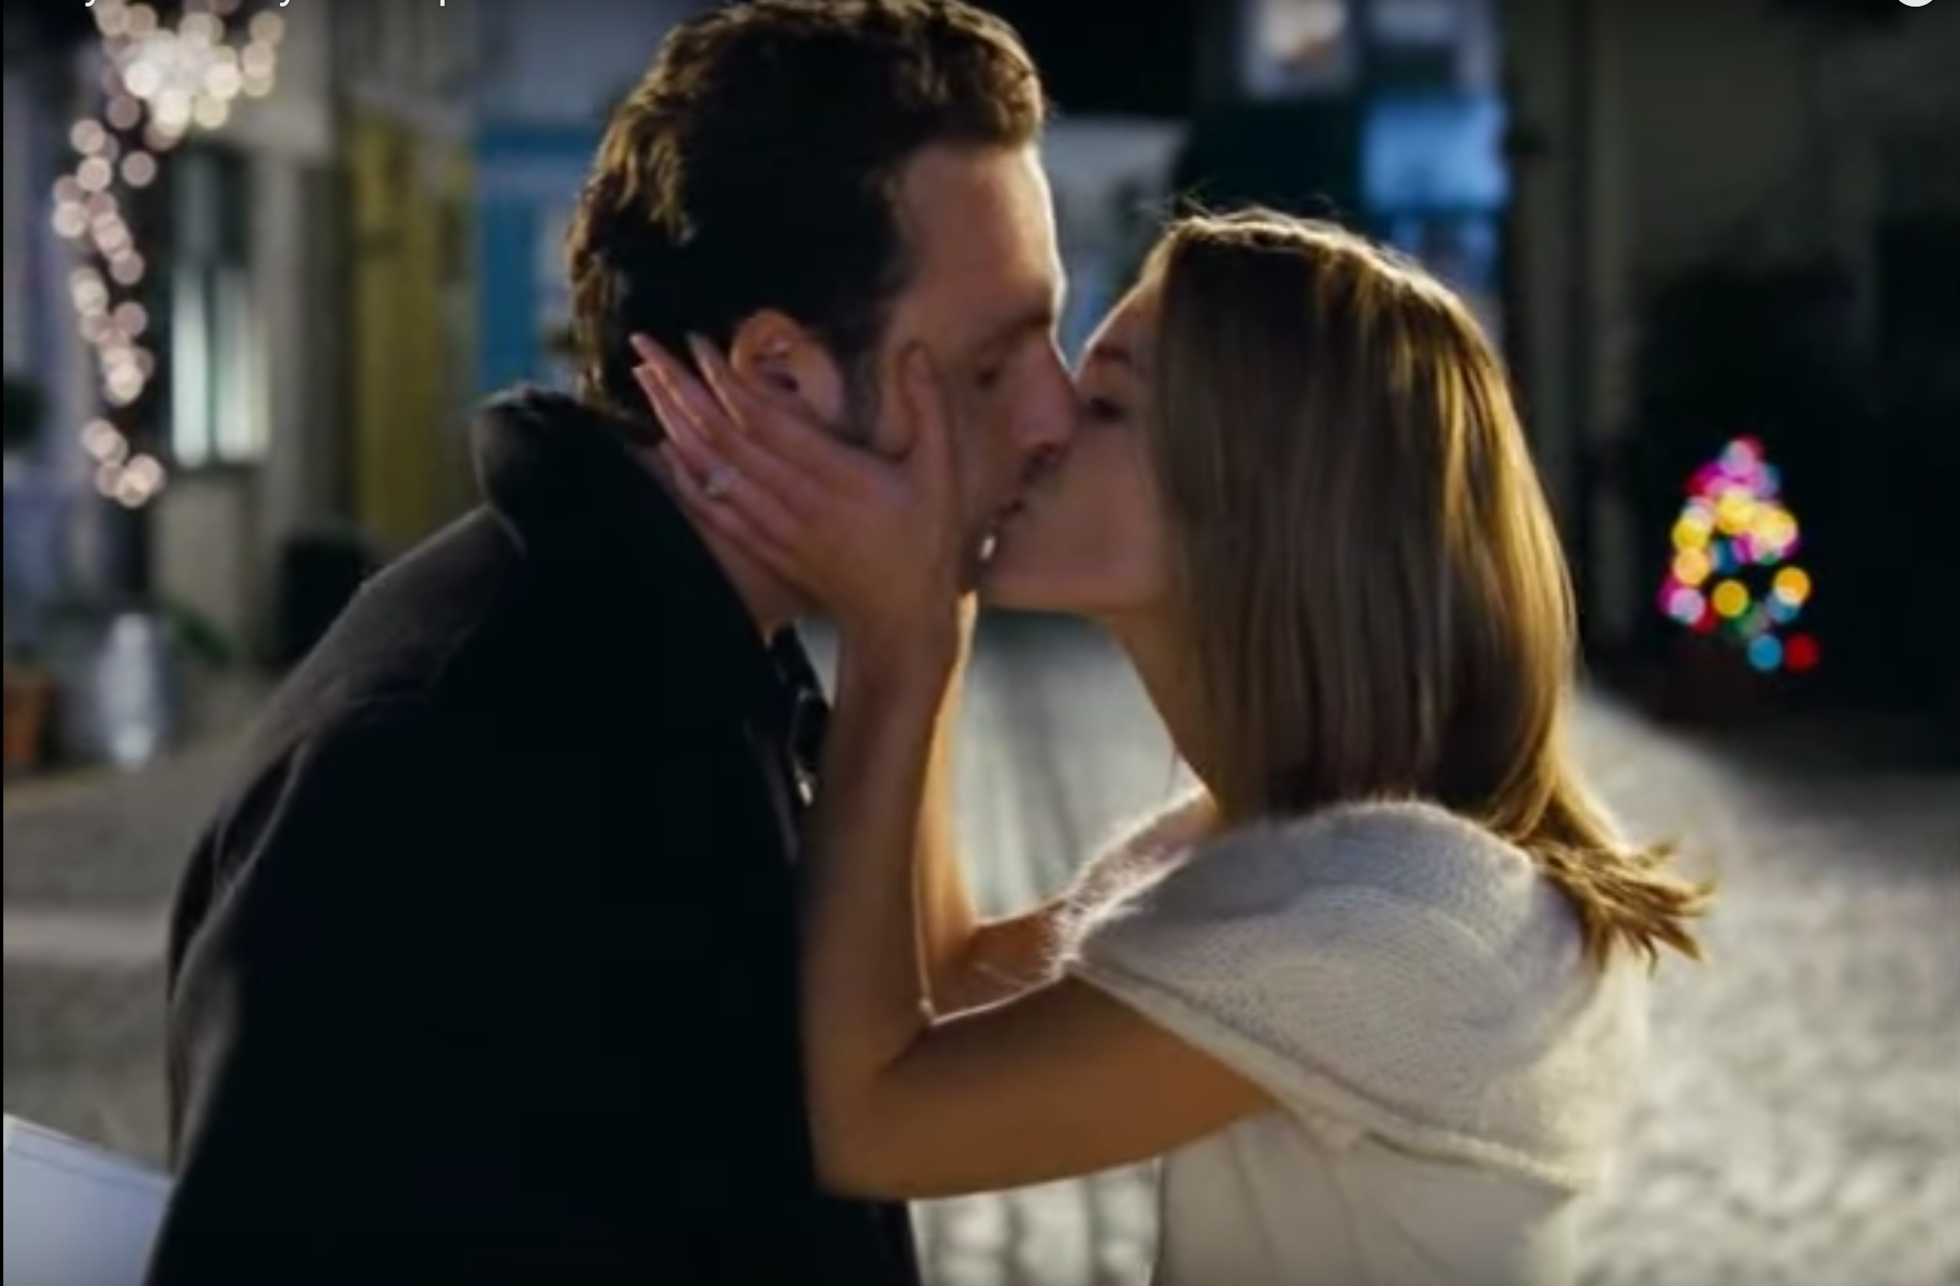
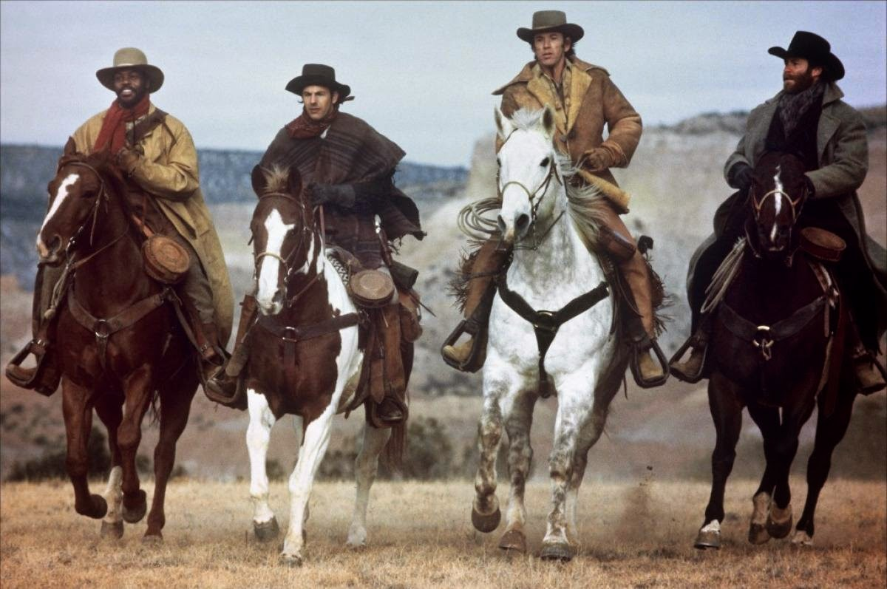

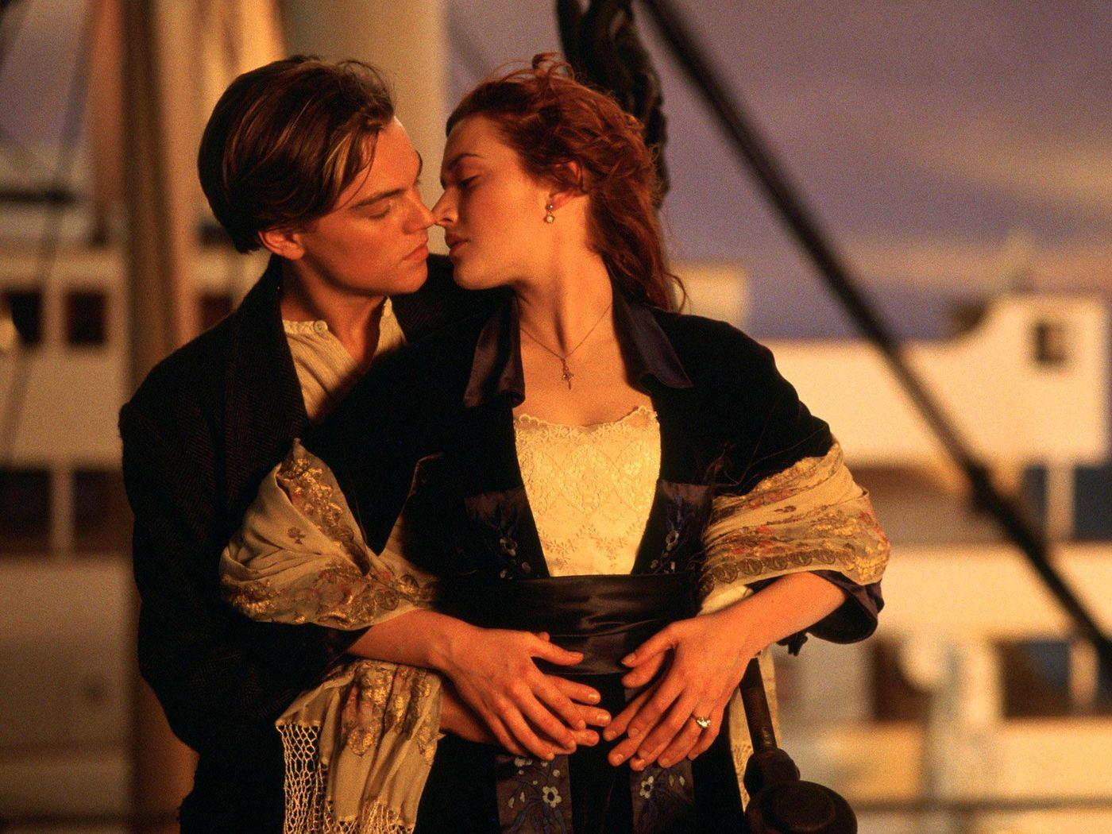
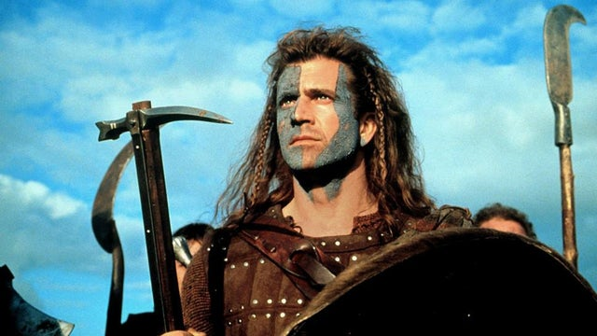
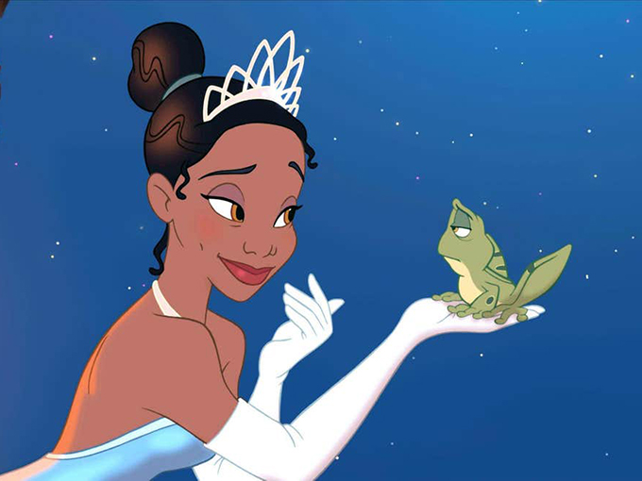

What is genre?

Slide 4

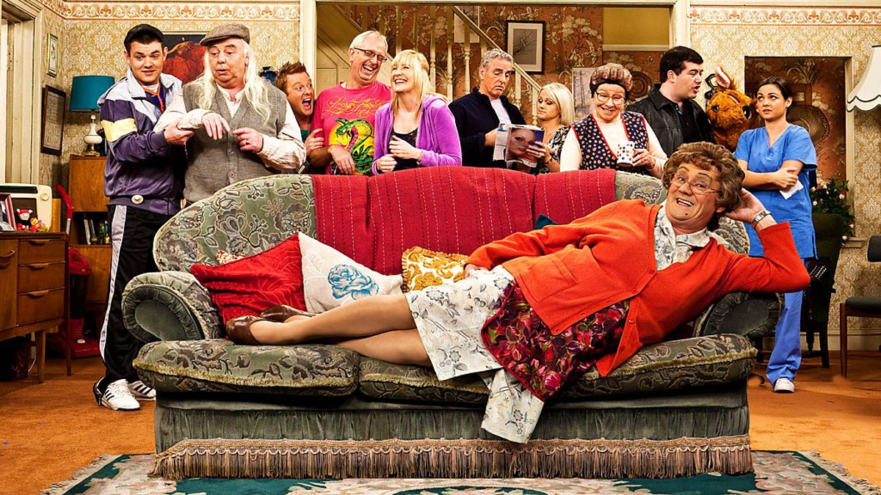
Sub-genre
Some genres are so broad – Comedy, for example – that one category doesn’t seem enough to include all of the different types of film that we might think of as being funny. In such cases, we use sub-genre to break this down further.
  Examples of comedy sub-genres include:
    Sitcom
    Slapstick
    Deadpan
    Children’s comedy
For example, Afterlife (Netflix) and Mrs Brown’s Boys (BBC) are wildly different in style and tone. One is slapstick and the other is deadpan. However, both are also part of the comedy sub-genre of Sitcoms.

Slide 5
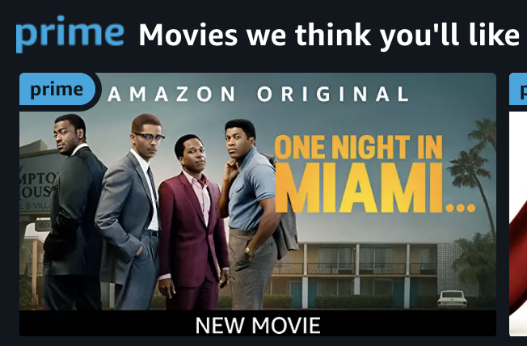
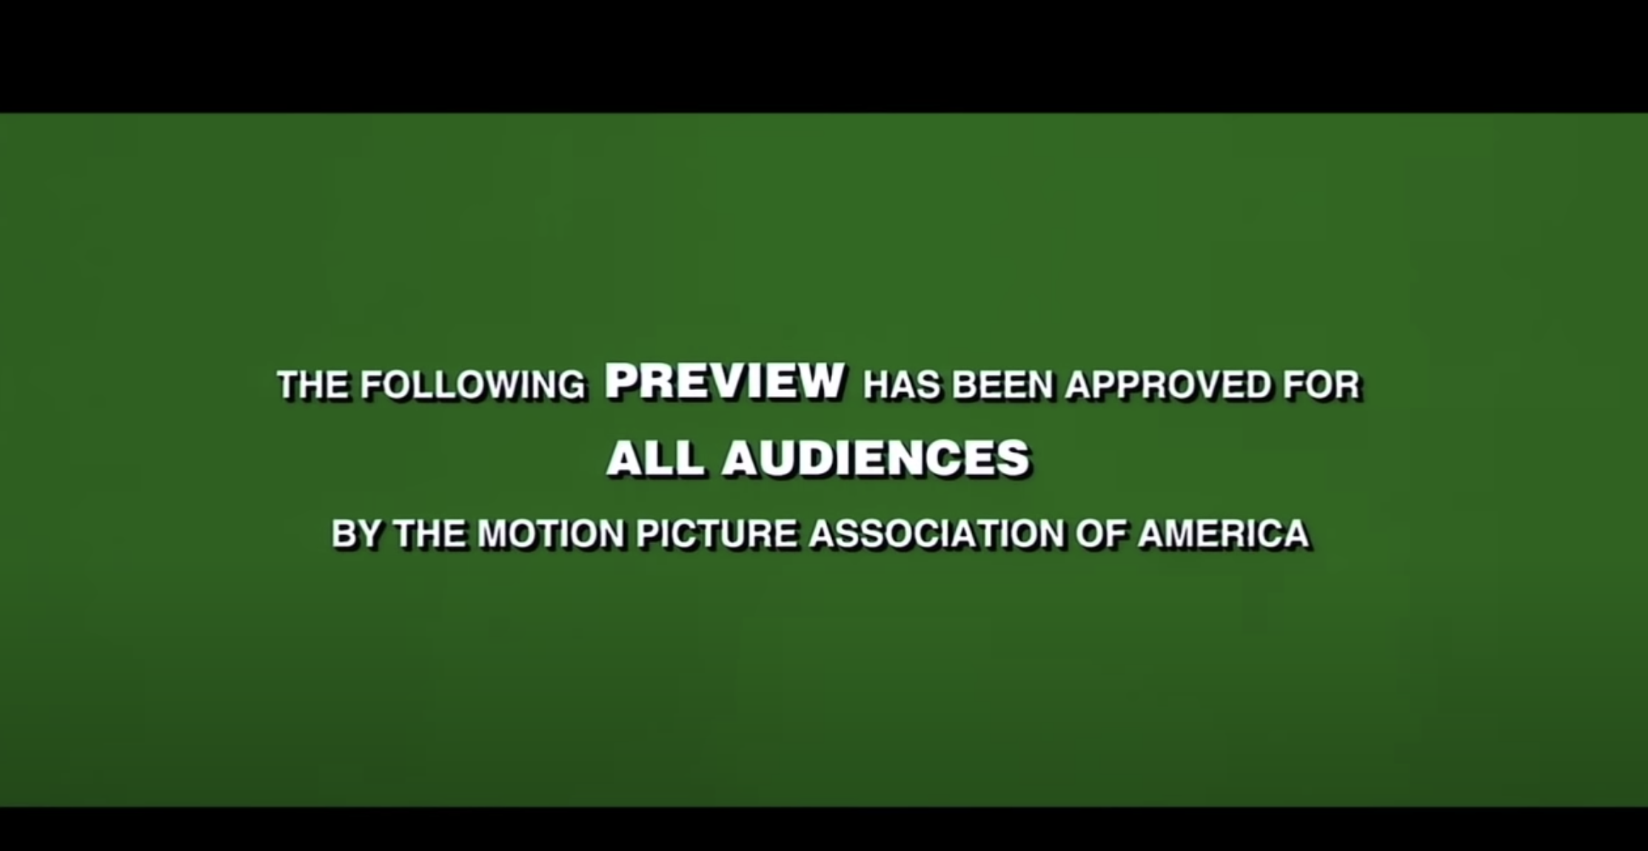
Why do we use genre?
Genre is an easy way to categorise films. Film advertisers use this to help sell us films they know we might like. With the rise of streaming services, this is becoming increasingly likely.
Films are talked about and awarded based on their genre: for example, there is an Oscar for Best Musical. Genre sets expectations which we hope the movie will meet.

Slide 6
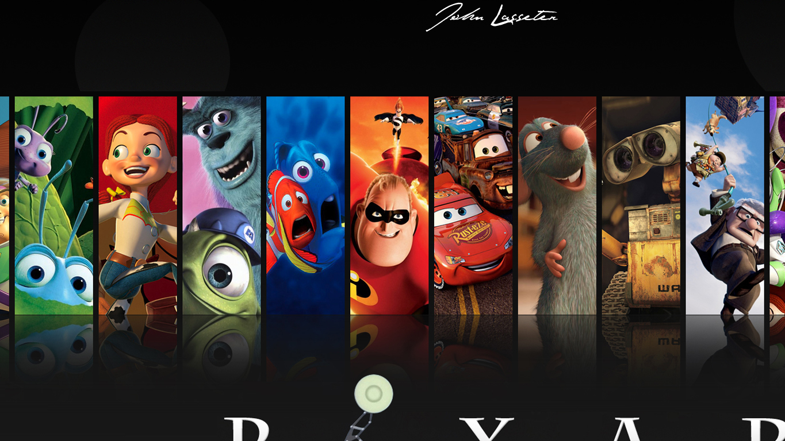
Critiques of genre
If we only watch what we know we’ll like, how do we ever discover something new? Also, as we have seen, many genres are contradictory, overlapping, out of date etc, so does genre even work as an accurate way of categorising films?
Some studios have become so refined at making their own types of movie that they could be said to be a genre in their own right. For example, the films of Pixar, Studio Ghibli, Disney or Marvel are easily identifiable.

Slide 7

How do we recognise genre?
We understand genre by looking out for signs that tell us the type of film this is. These are signs we come to expect from films of that type.
For example, in a horror film, we might expect to see blood, dark scenes, death etc. In a musical, we’d expect to see bright colours, a happy ending, people singing.
These identifiable features are called Tropes. Tropes are the things we look for that tell us what kind of film we’re watching.
When a film sticks to the expectations of a genre, we say that it Conforms to expectations. The Saw movies conform to the expectations of the Horror genre, for example.
When a film isn’t quite what we might expect from a certain genre, we say that it Subverts expectations.
Watch the clip below from Logan and list as many Tropes as you can from the Superhero genre. Does the clip conform or subvert your expectations? https://www.youtube.com/watch?v=HlNZZKvbJII

Slide 8

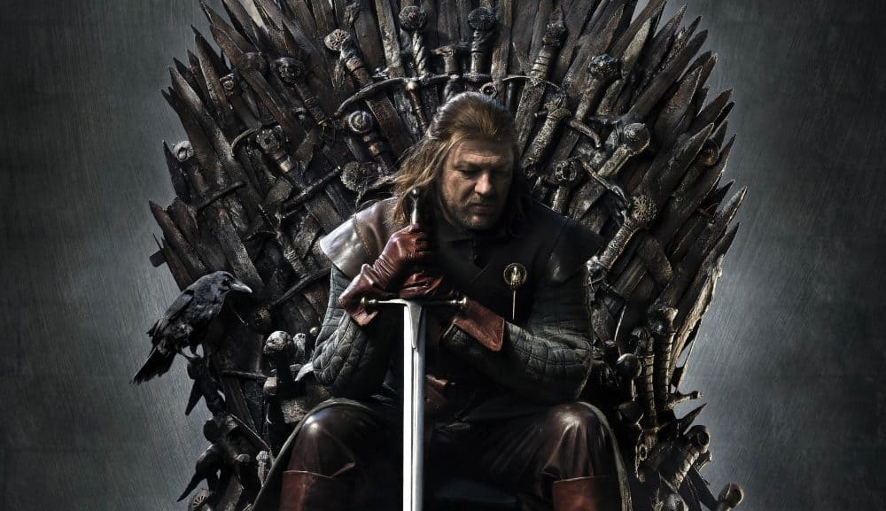
Genres change over time
A horror film from the 1940’s would probably not seem very scary to us now. This is because genres change and develop over time.
  Batman 1966: https://www.youtube.com/watch?v=-OZKOJ8_Big
  The Dark Knight: https://www.youtube.com/watch?v=u3nnNM5q0AI
  Joker: https://www.youtube.com/watch?v=BBY4zUFxUjA
If a genre does not develop, it may stop being relevant. We call this a dead genre.
A dead genre can be revived. For example, after a string of low-budget, cheesy fantasy films, The Lord of the Rings revitalized the fantasy genre which led to its huge surge in popularity in recent years with shows such as Game of Thrones.

Slide 9
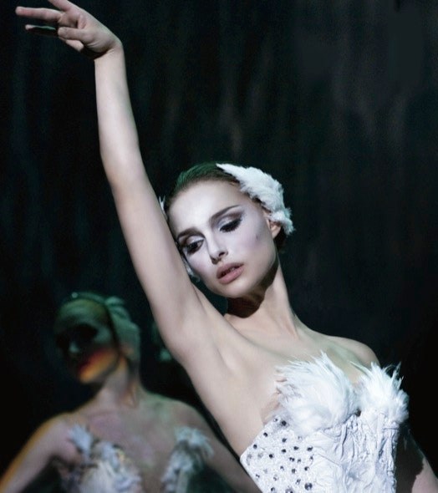
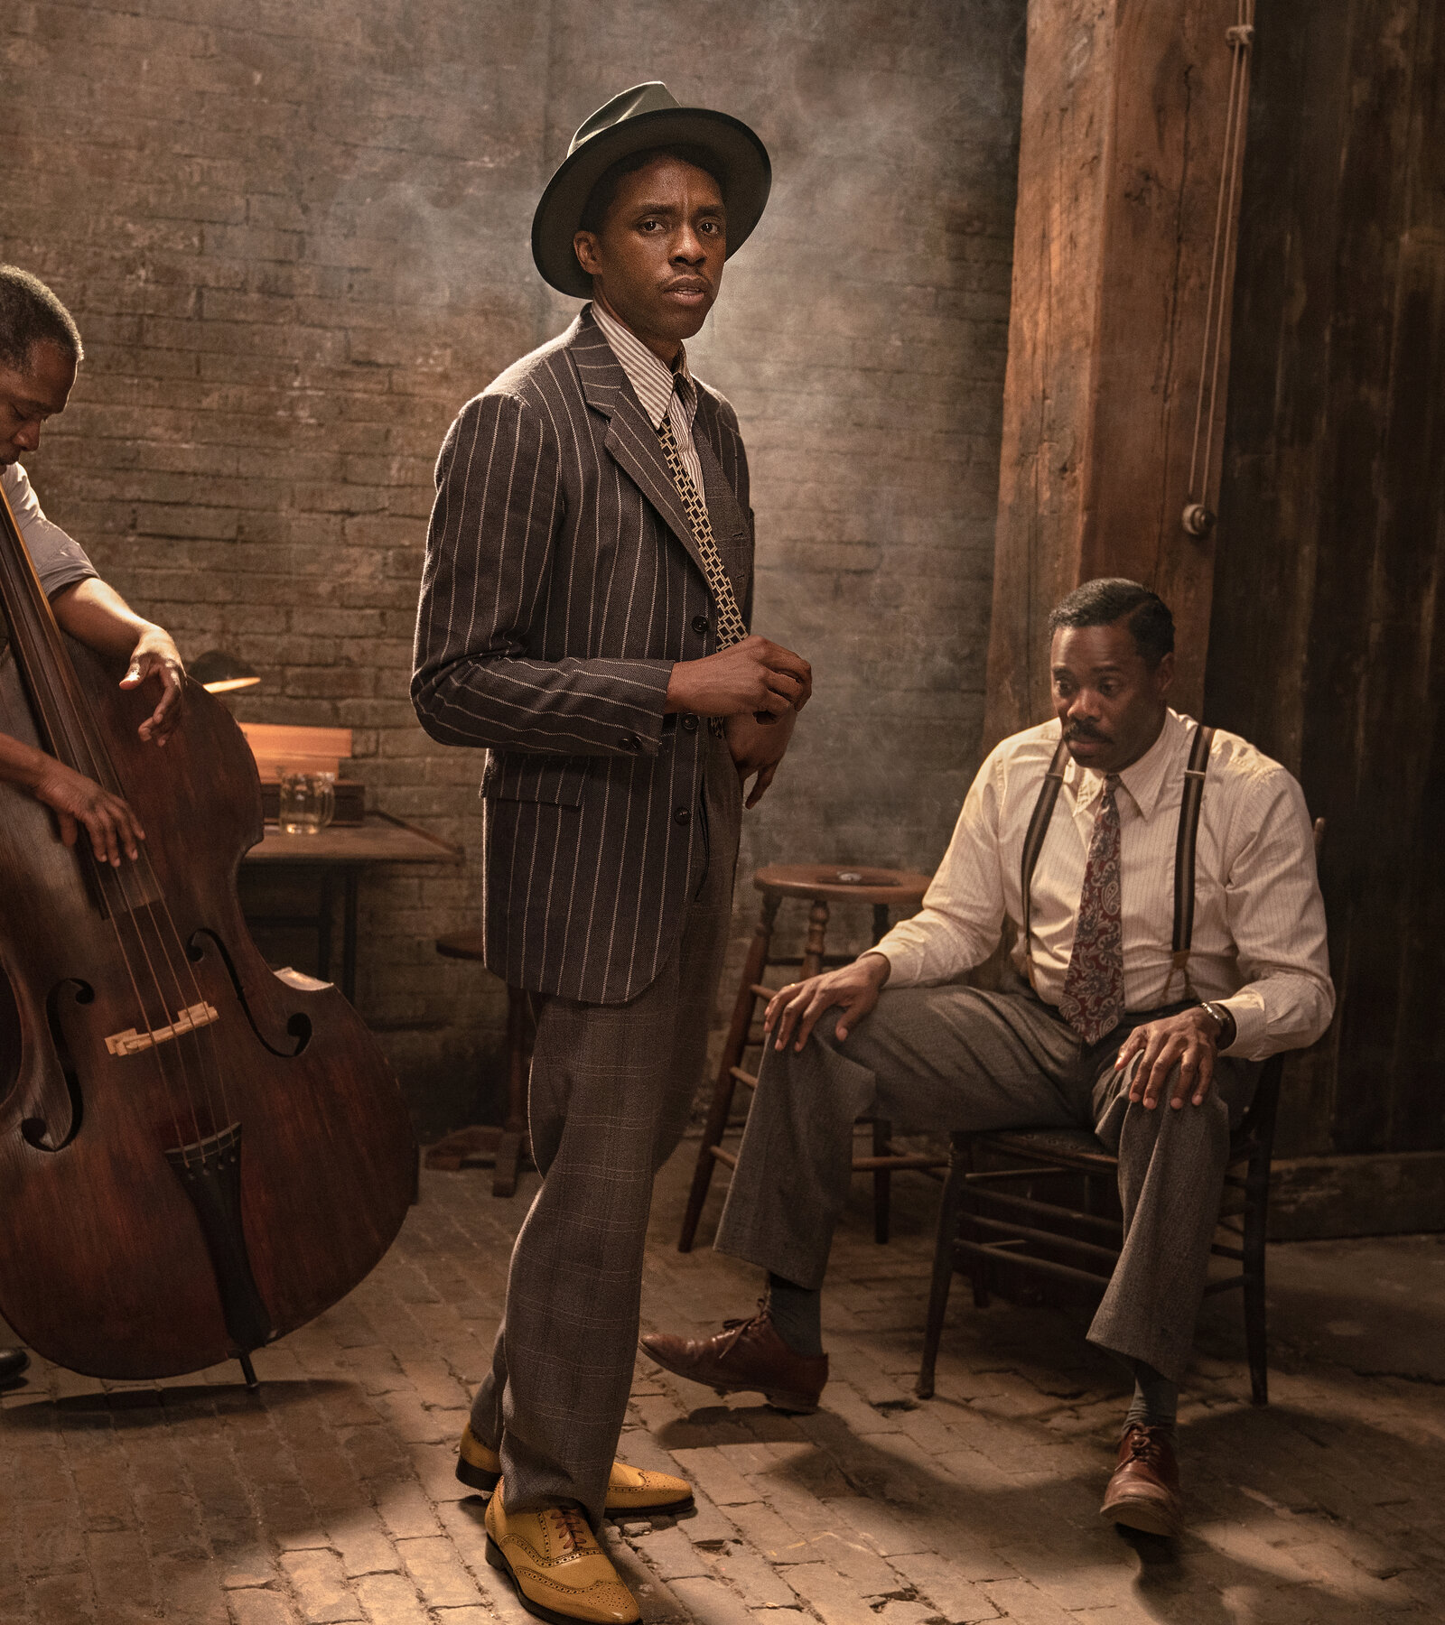
GUESS THE GENRE
For 15 minutes, work through some of the film trailers on the handout (available via the course website). Watch the trailers and see if you can identify the genre.

Slide 10

Homework
Continue your Key Words Blog with the words from this week.
  Genre
  Sub-genre
  Trope
  Conform
  Subvert
Think of your favourite film. Write 400 words about how it subverts and conforms the expectations of its particular genre. Remember to include a reference to the film itself.

