Slide 1
The
Media
Industry
Research and context in media

Slide 2
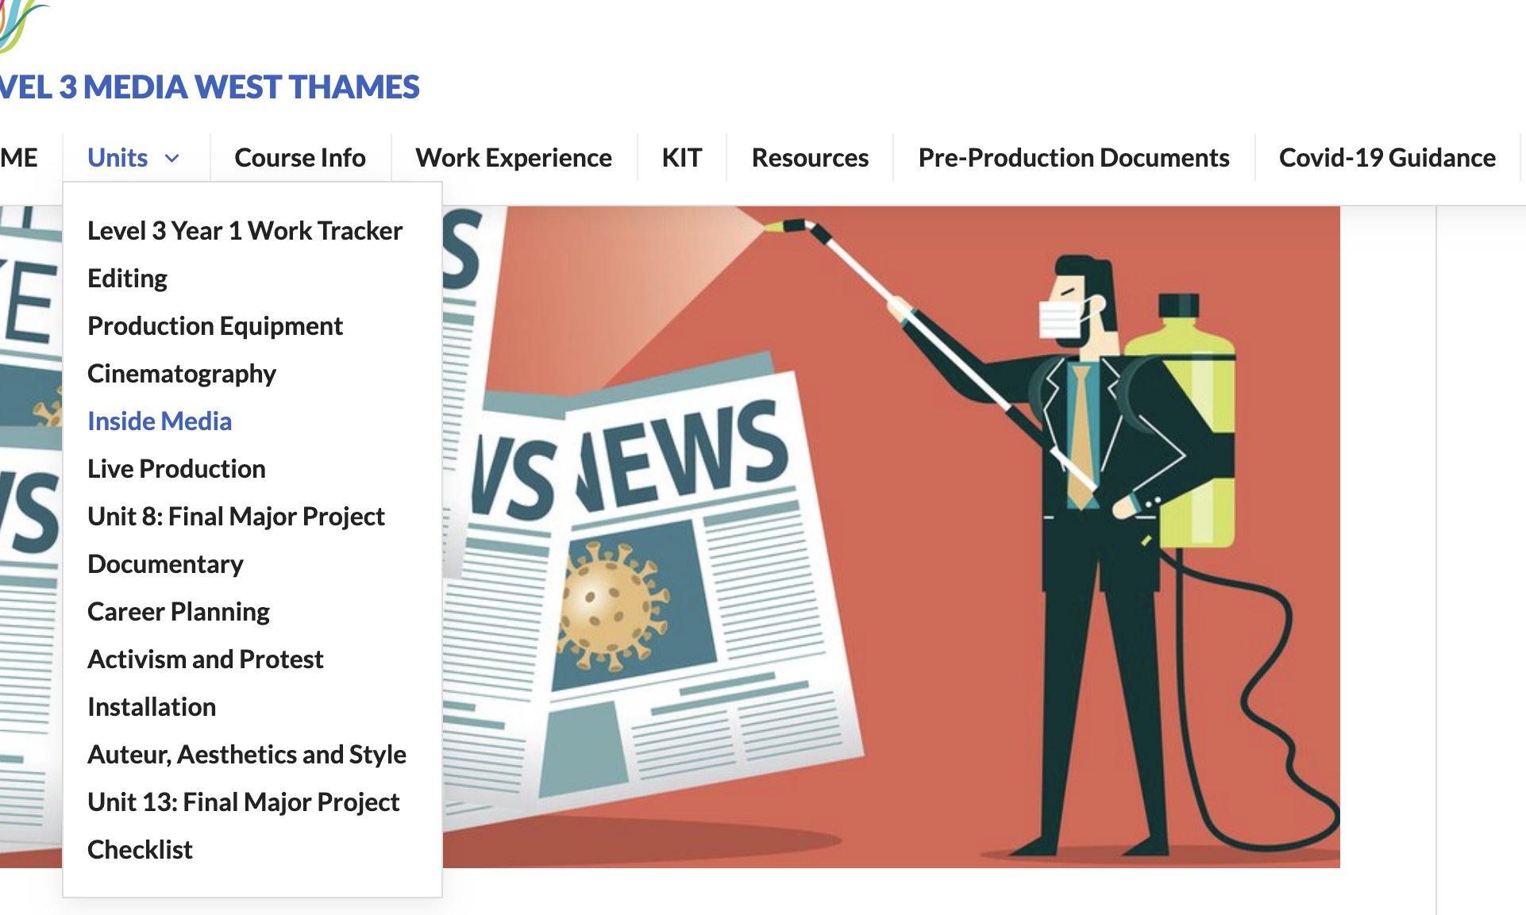
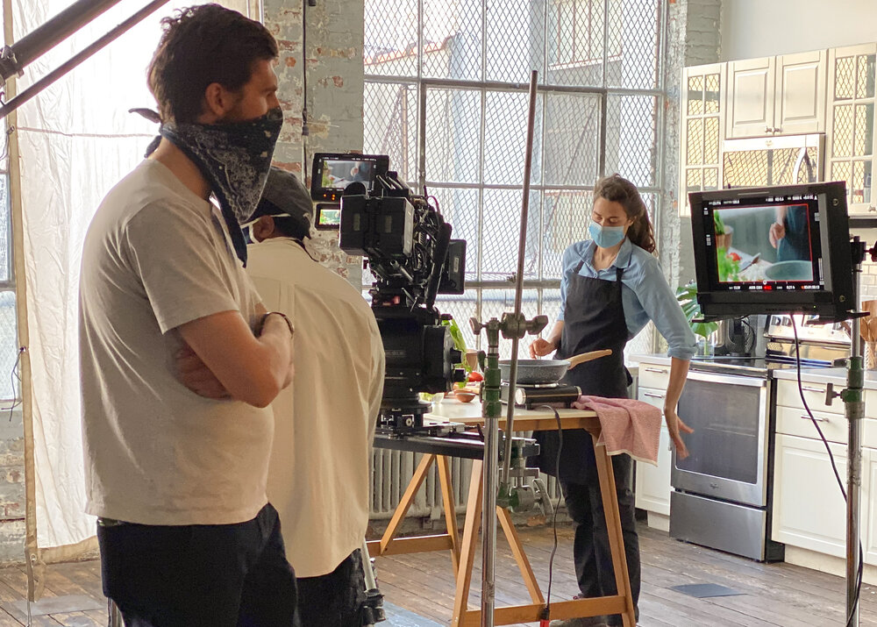
The Unit
Assignment Brief: https://l3mediahome.files.wordpress.com/2020/12/unit4.pdf
Tasks:
  Key Terms Blog
  Licence Fee Writeup (500 words)
  Auteur Theory Presentation

Slide 3


Media = Agenda
Media exists alongside an agenda. Sometimes this agenda is for the broader good; for example to educate and to inform. Sometimes this is to spread a political and personal viewpoint, or to get more subscribers.
This all boils down to the need to attract attention.

Slide 4
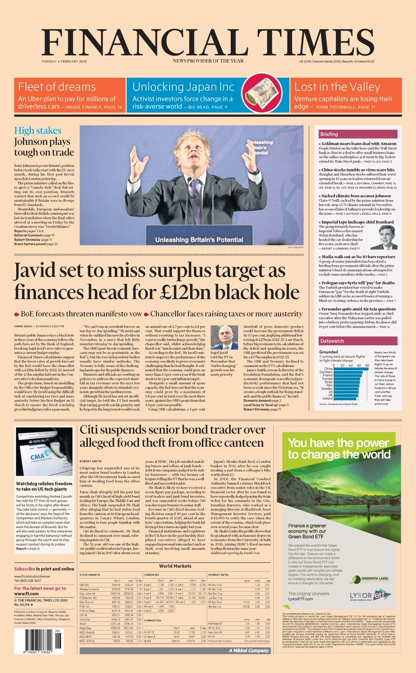

Colour
Daily Star = 60p / FT = £2.90
Star talks about sex, sport and TV
FT headlines a lot smaller and wordier
Much less use of images in FT
FT is physically bigger than the Star
More dramatic language in the Star: ‘killed off’
The Daily Star is an example of a TABLOID newspaper. Financial Times is an example of a BROADSHEET.

Slide 5
Understanding Context
BBC
Sky
Netflix
ITV
Channel 4
In groups, you must research your assigned TV channel. Find out how it is funded, what is is or isn’t allowed to show, and what makes it different from the others. Put your findings into a short presentation to feed back to the group. Include some example programmes to help back up your point. Remember to reference your research sources.

Slide 6
Understanding Context
BBC
Public Service Broadcaster
Sky
ITV
Advert funded channel
Channel 4
Netflix
Streaming service

Slide 7

Research Sources
Books
Websites
Films
Documentaries
Newspapers
Trusted
Maybe Trusted?
Not trusted

Slide 8
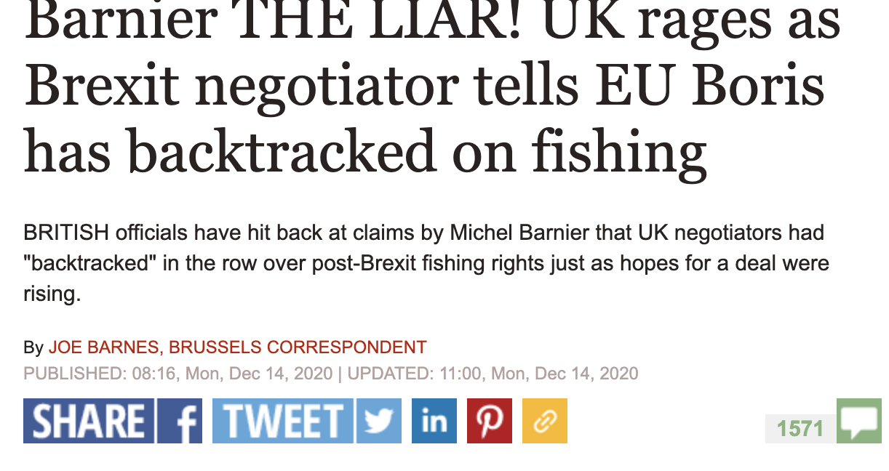
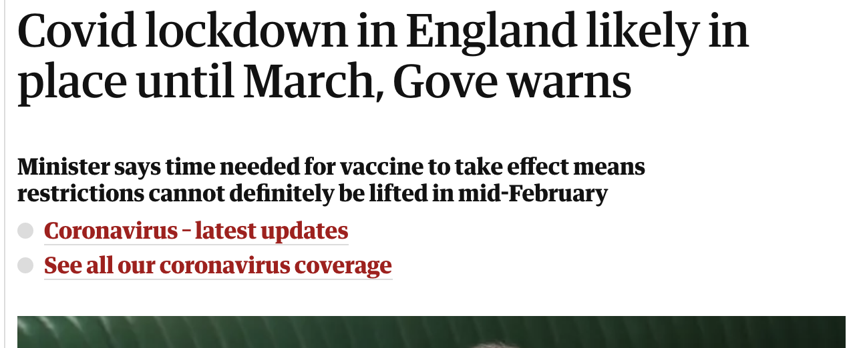
Task
Compare and contrast the two online news articles. Look at everything from the use of language to the size of images, inclusion of adverts etc. What does this tell you about who the audience is? What is the agenda?

Slide 9
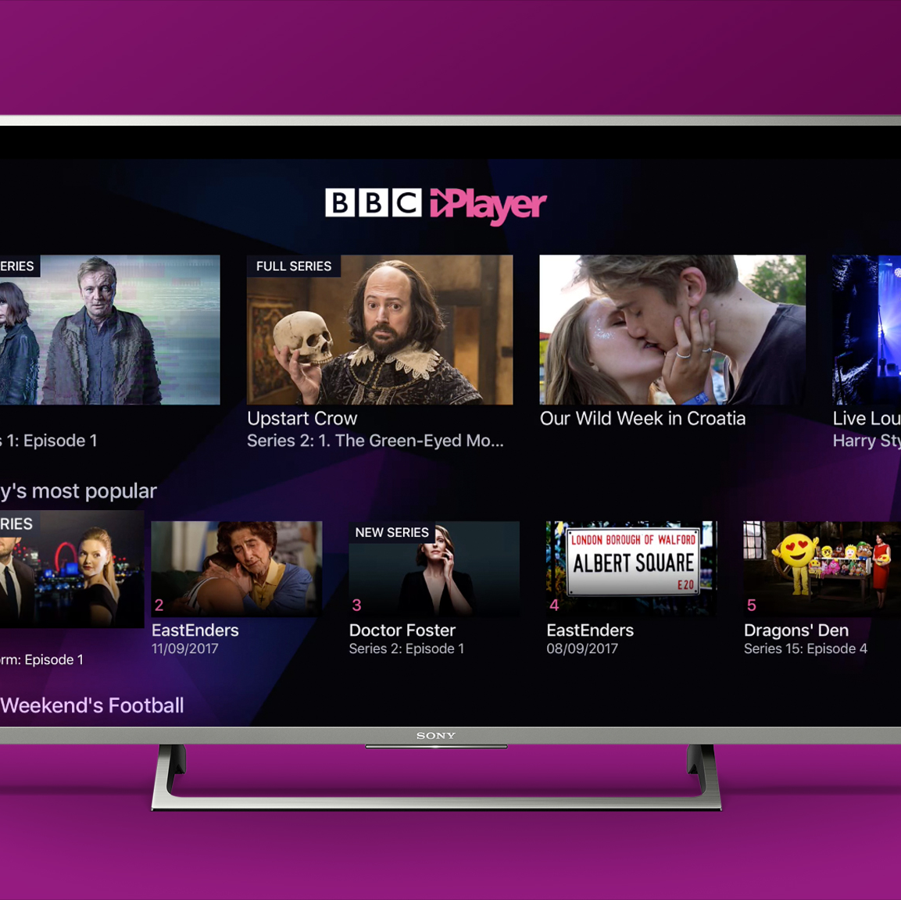
Homework
Begin your Key Words Blog with the words from this week.
  Tabloid
  Broadsheet
  Agenda
  Source
  Public Service Broadcaster
Remember to include a definition, an example, and to research from a range of sources.

