Slide 1

INTERVIEW
AND JOBS
Getting the place – week 4

Slide 2
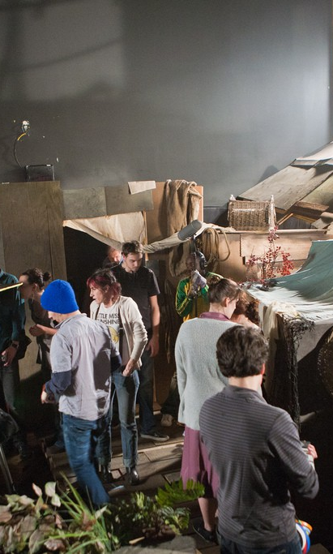
Homework
Complete the last touches on your showreel and / or portfolios.
  If you think you’ve double-checked it, triple check it. Don’t make silly mistakes with spelling and grammar. Get somebody else to look over it.
Whatever is appropriate, based on what you have created, make sure you embed for marking somehow into your new Wix/Wordpress page.
Complete the questions on the last slide in preparation for next week.

Slide 3
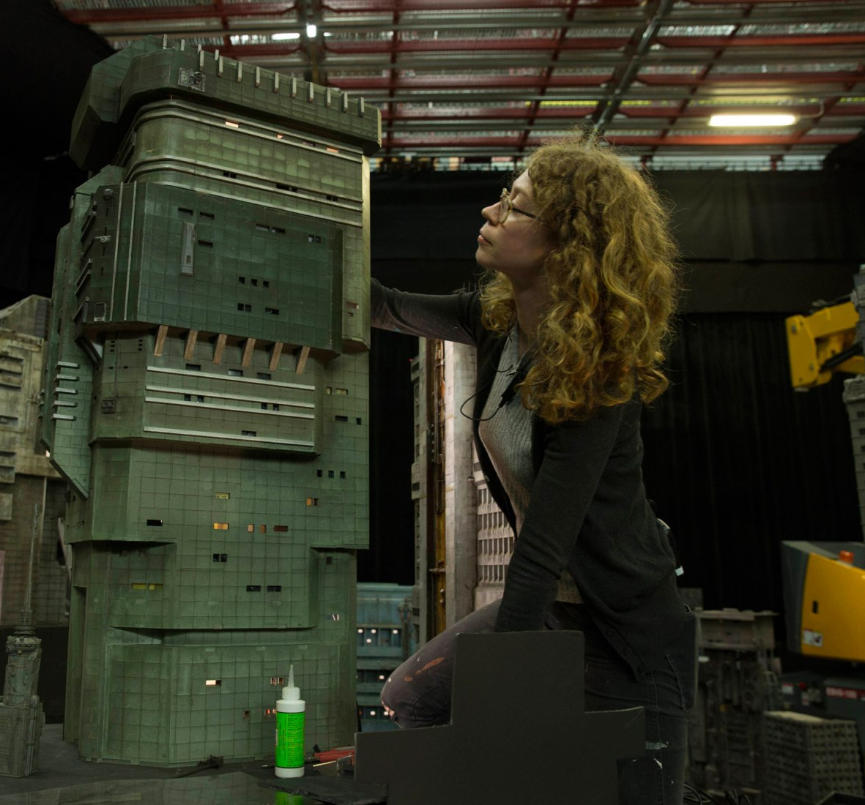
Today’s lesson
Making a good impression
Knowing what helps you stand out
Where to look for jobs
Preparation for interview

Slide 4

What job?
Places to search for work include:
  Mandy Network: https://www.mandy.com/uk/jobs
  ProductionBase: https://www.productionbase.co.uk/film-tv-jobs
  London Filmmakers Network: https://www.facebook.com/groups/londonfilmuk/
  Student Filmmakers and Actors Network: https://www.facebook.com/groups/1125799544214462/
  MyFirstJobInFilm: https://myfirstjobinfilm.com/UK
How do I know what job I’m looking for?
  Look for entry level jobs
  Use the infographs here to help: https://www.screenskills.com/careers/job-profiles/

Slide 5
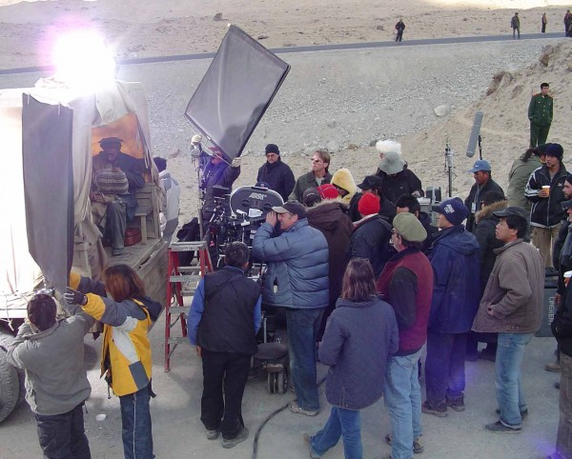
Understanding the job
Do Your Research
Understanding the job is the first step towards getting it. Whether it’s a student project or professional, there will be a lot of competition. Use these tips to stand out.
Don’t copy and paste an application
Have work ready to show
Make them want to work with you
Accept that you will get rejected a lot. Don’t burn bridges.
Example student job app: https://www.mandy.com/uk/job/1349708/tiger-hunts-in-darkness/cinematographer
https://www.mandy.com/uk/job/1352471/broken-down/sound-recordist
Example professional job app: https://www.mandy.com/us/job/1368870/3d-production-coordinator/production-coordinator

Slide 6

a foot in the door
Entry level jobs and apprenticeships are often the ‘first step’ into the media industry. Sometimes these can be accessed by entry-level schemes or apprenticeships. Some require a degree; others would be accessible to people completing the Level 3 Creative Media extended diploma.
How to get work as a runner? https://www.screenskills.com/insight/masterclasses/anna-bonaddio/
Where can I find apprenticeships? https://www.screenskills.com/education-training/apprenticeships/where-can-i-find-an-apprenticeship/
How do I work in the film industry? https://www.bfi.org.uk/bfi-film-academy-opportunities-young-creatives/bfi-film-academy-how-do-i-work-film-television-industries

Slide 7
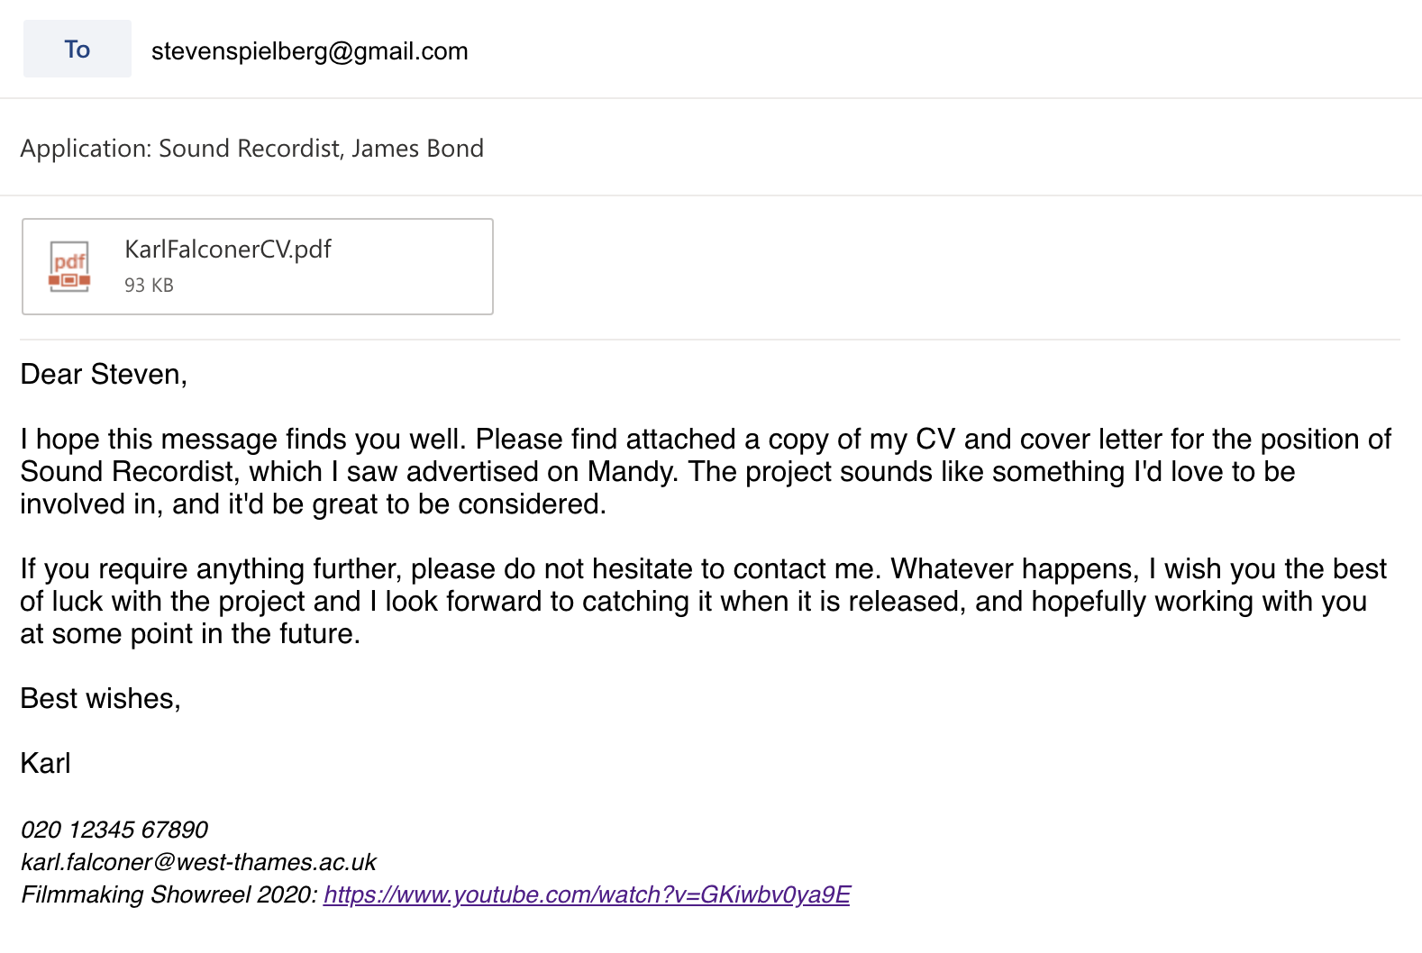
THE First Impression
First impressions count
Send them everything they ask for, and nothing more
Check your presence online. Does it give
off the impression you want it to?
Follow the example for how to write a CORRECT email!

Slide 8

Thinking of going freelance?
The Freelance Toolkit: https://www.screenskills.com/careers/freelance-toolkit/

Slide 9
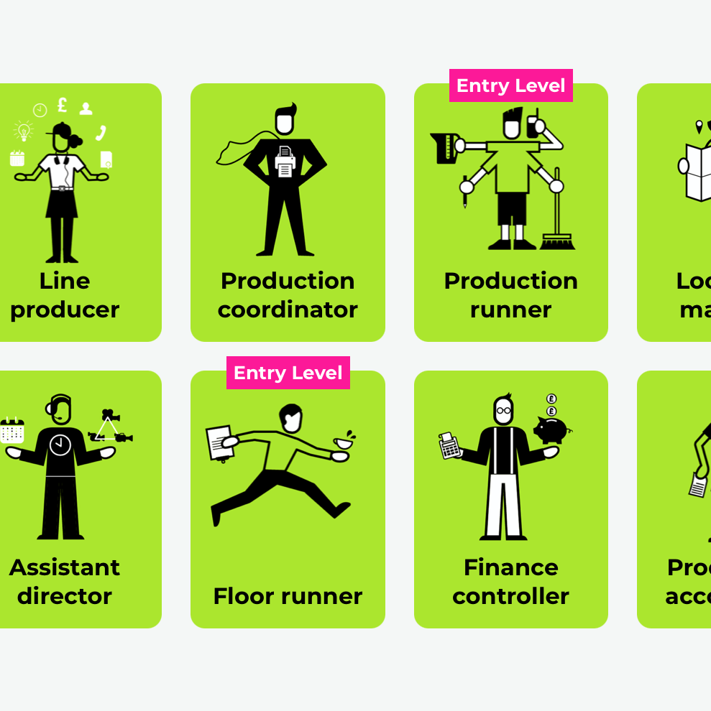
Career Planning
In five years from now:
Where do you want to be and why?
What do you want to be and why?
Who do you want to be and why?
Look at the example career plan here for a Sound Recordist. Use it to complete your own Career Plan. You can stick to this template or use your own: https://myfirstjobinfilm.com/files/SoundTrainee%20(1).pdf
https://www2.bfi.org.uk/sites/bfi.org.uk/files/downloads/future-film-skills-an-action-plan-2017.pdf

Slide 10

Homework
Complete your career plan using the template on the course website. You may use this to identify opportunities to apply for – go for it!

