Slide 1
Portfolio creation
Getting ready for the future

Slide 2
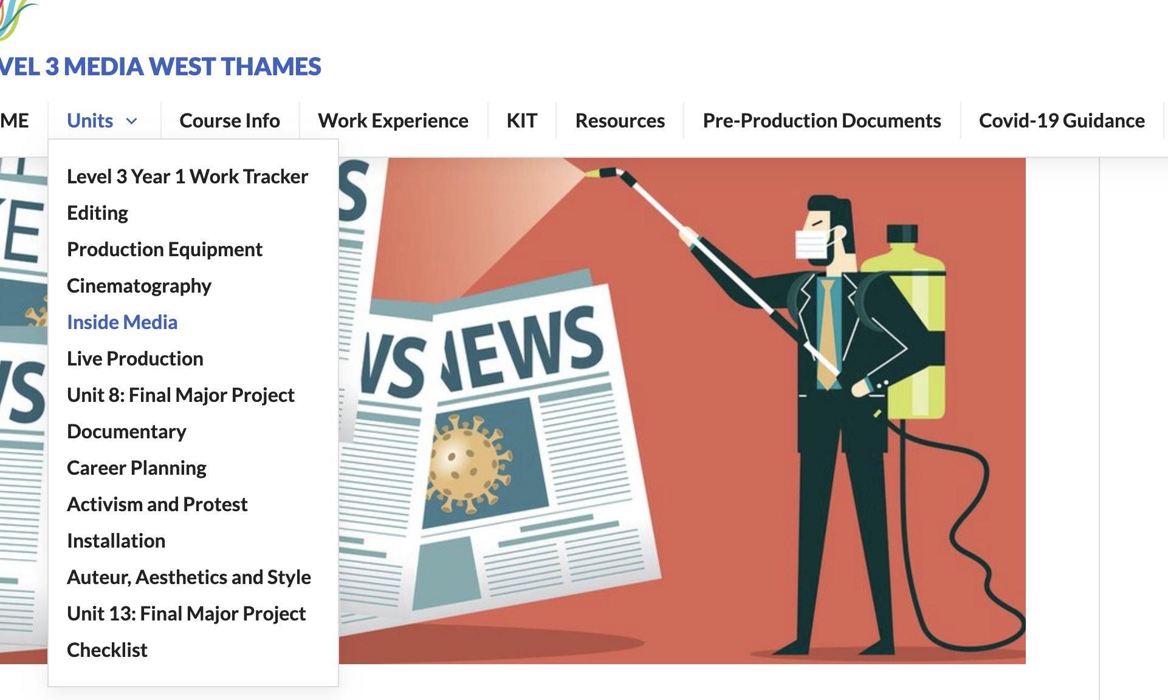
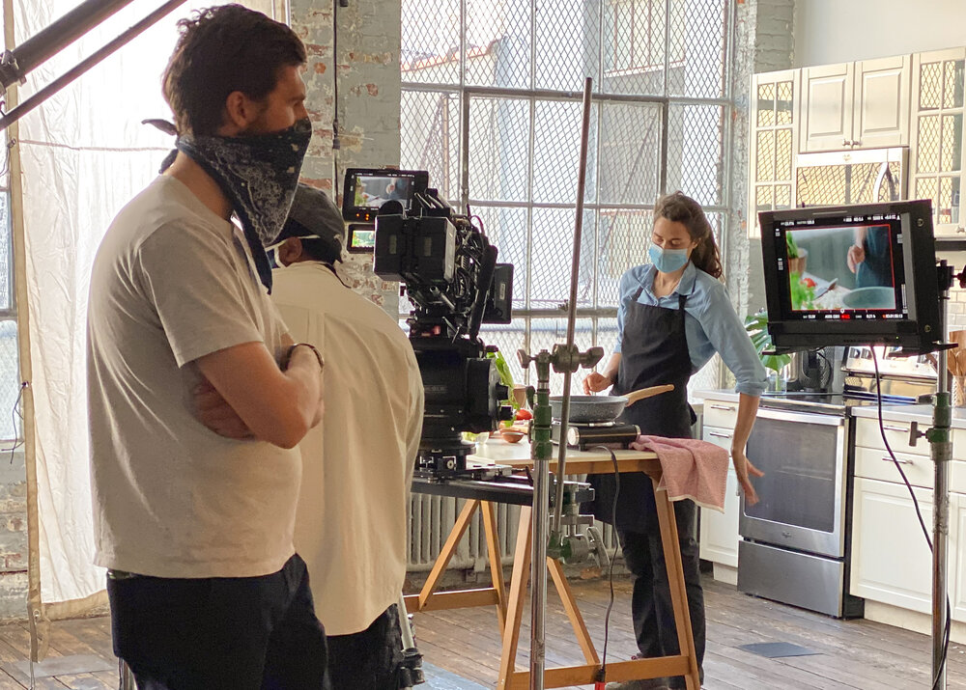
The Unit
Assignment Brief: https://l3mediahome.files.wordpress.com/2020/12/unit11.pdf
Tasks:
  Career plan
  Showreel
  Media Interview
  UCAS Application

Slide 3
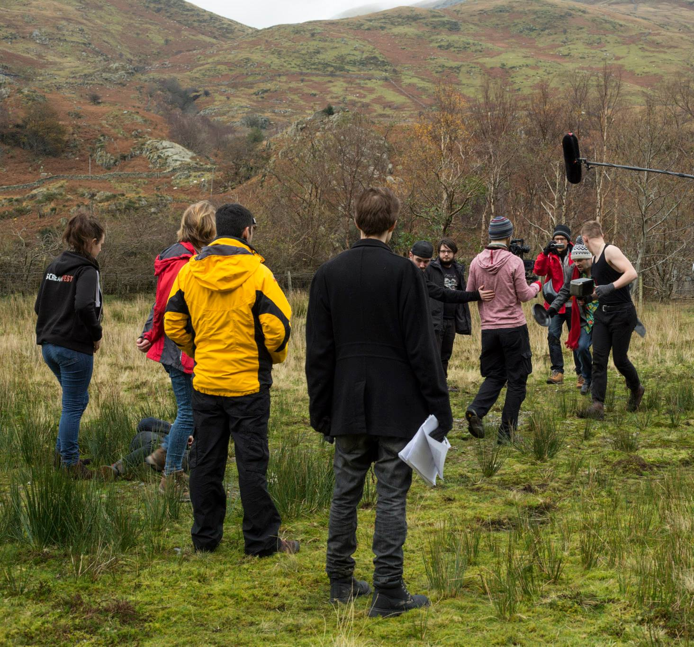
PREPARING FOR THE FMP
You will be assigned a Job Role
This unit is designed to prepare you for the FMP
Across 10 weeks we will make the film

Slide 4

TASK - reflection
Documentary Feedback
In small groups, discuss how you think your documentary went. Come up with three things you want to work on and improve this term. These targets should be added to your blog later.

Slide 5
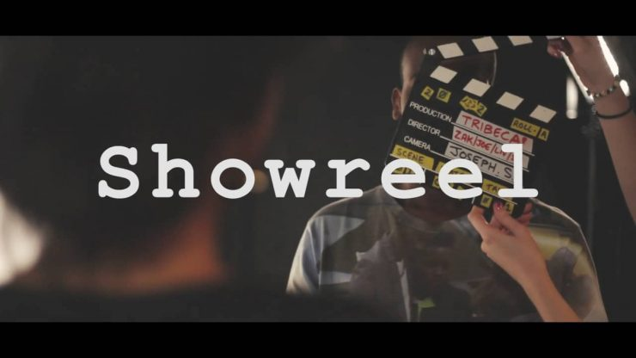
Selling Yourself
In many other job markets, a CV is enough to secure an interview, as it can tell a potential employer everything they want to know. But for those who work in the creative industries, actually being able to see and to show examples of work is crucial. For media, this can often take the form of a showreel. But what are the pros and cons of this and what does a good showreel actually look like?
Example showreel: https://www.youtube.com/watch?v=ugQuUigKSwg

Slide 6
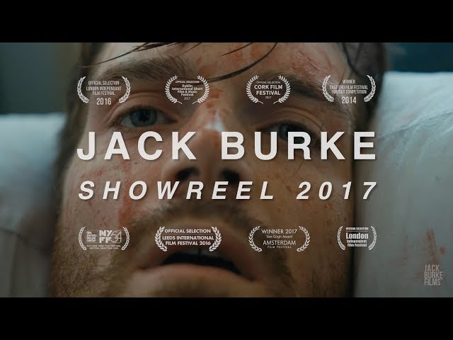
Pros and Cons
Pros
Cons
Visual
Show your best work
Easily show your skill
Free
Show off awards etc
Only shows snippets
Need a lot of footage?
Who will watch it?
Do they actually work on their own?
https://www.youtube.com/watch?v=syoi0c5BQog&t=22s
https://www.jackburkefilms.com/

Slide 7
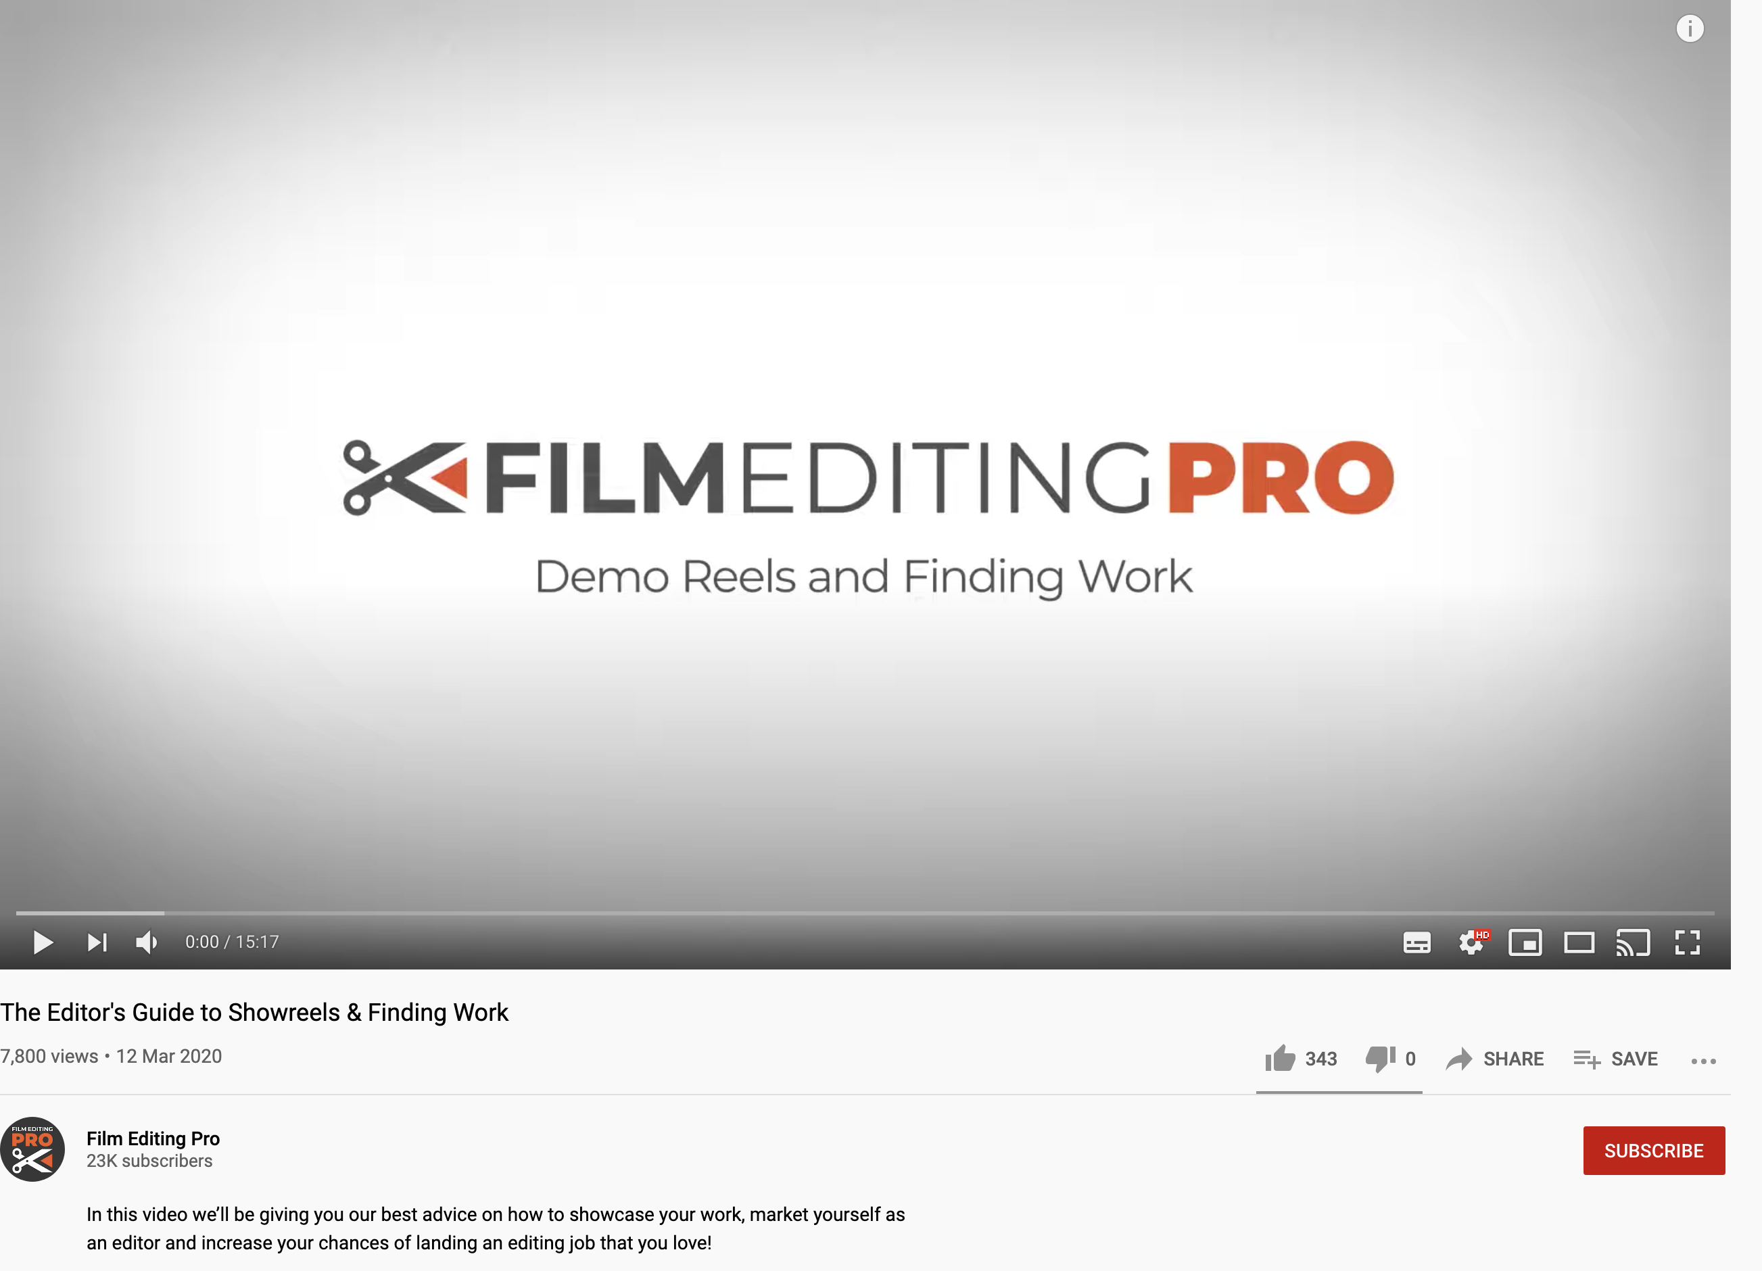
Understanding Context
How to make your reel
6 Ways to make your showreel stand out

Slide 8
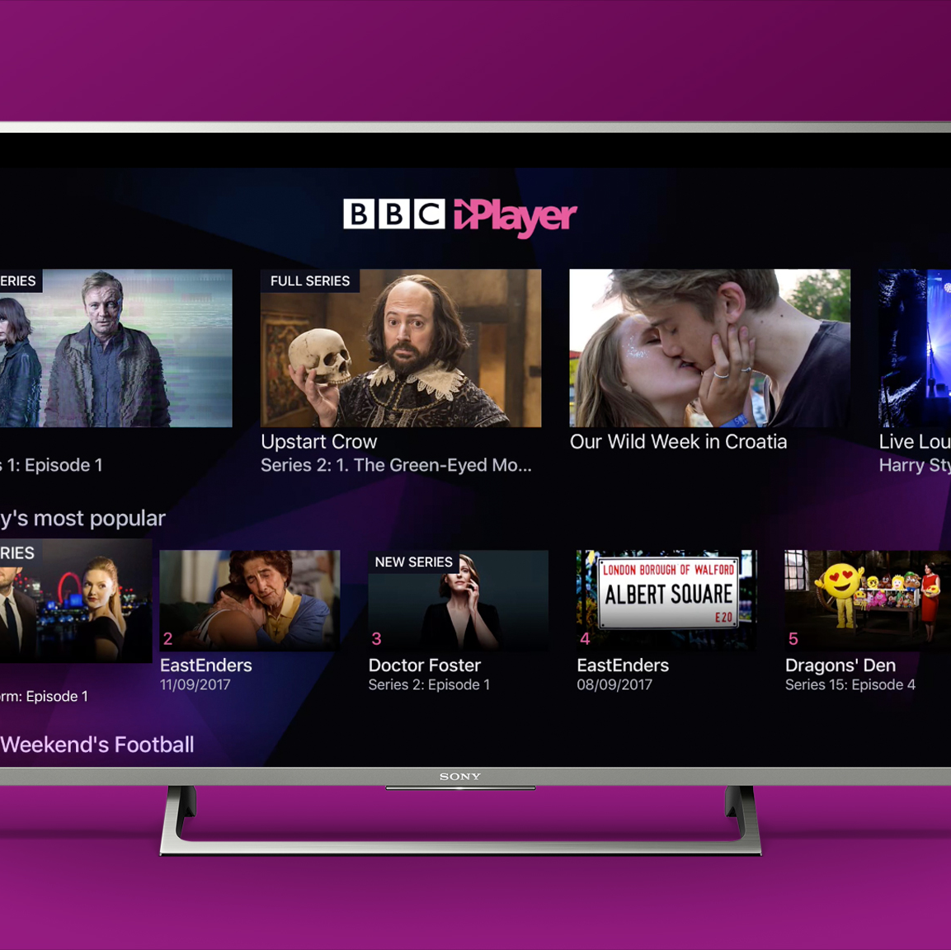
Homework
Add your three documentary targets to the top of your new unit tab on Wordpress/Wix.
Collect all of the ‘best bits’ of your existing footage.

