Slide 1
Documentary
Modalities

Slide 2
Nichols’ Introduction to Documentary
Six modes of representation:
  Poetic
  Expository
  Participatory
  Observational
  Reflexive
  Performative

Slide 3
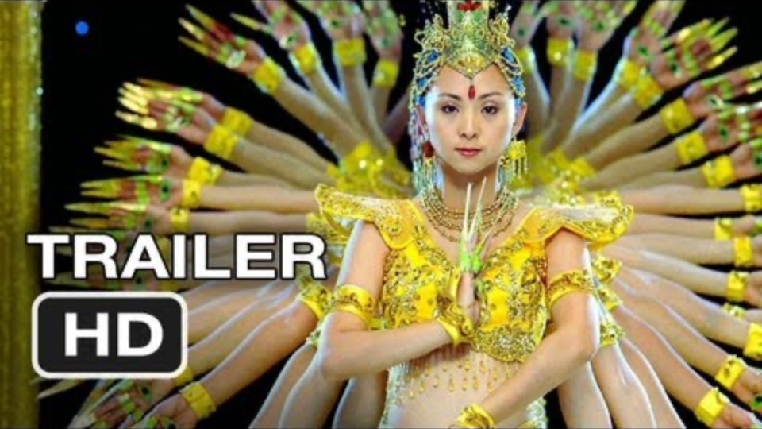
POetic
Instead of using traditional linear continuity to create story structure, the poetic documentary filmmaker arrives at its point by arranging footage in an order to evoke an audience association through tone, rhythm, or spatial juxtaposition.
‘A subjective interpretation of the subject’ – essentially, it is biased
Certain information is left out in order to support this point of view

Slide 4
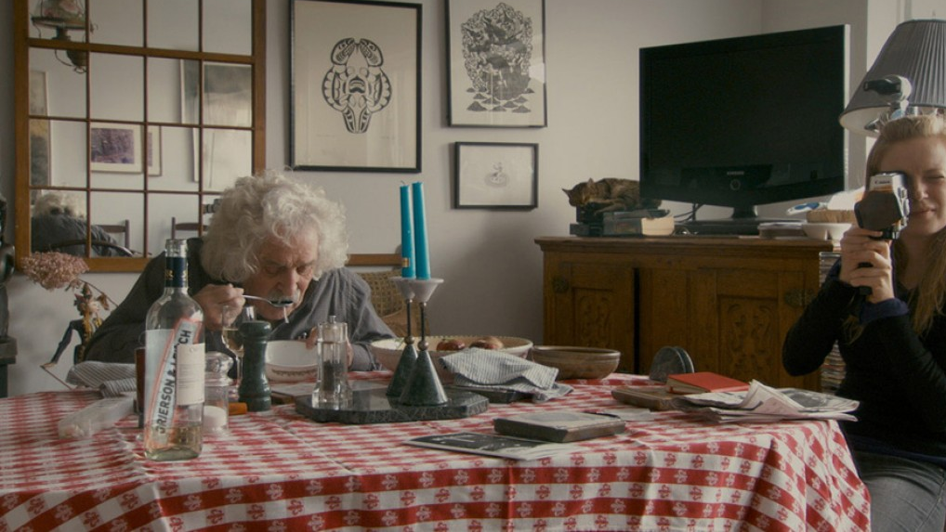
Expository
The documentor speaks directly to the viewer, through the use of tools such as voice over and subtitles to create a strong argument.
In this mode, images are used to support the message being conveyed by the filmmaker.
Is it as interesting to simply list the ‘facts’?

Slide 5
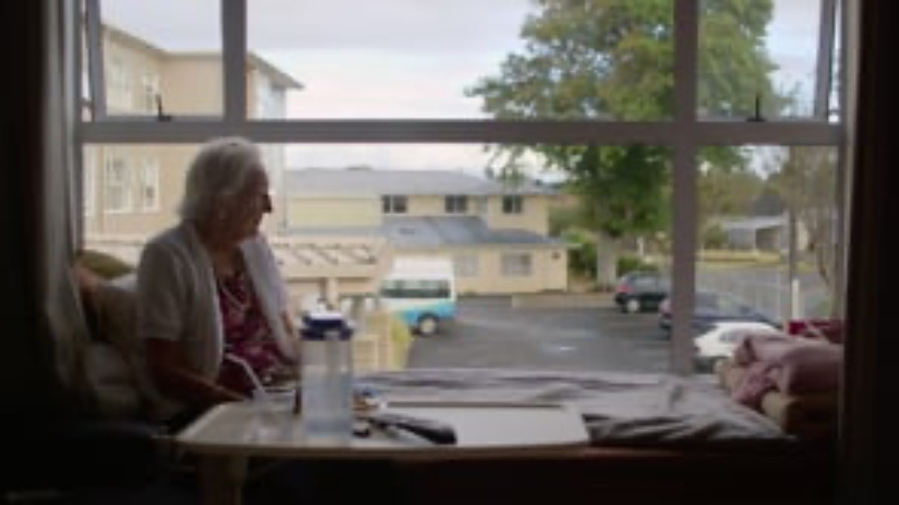
Observational
Emerging in the 60’s, Direct Cinema embraced the idea of the observational documentary format
The camera captures the ‘truth’ by letting the camera capture its subjects uninterrupted
Arguably more of an ‘unbiased’ methodology
Think: fly on the wall

Slide 6

participatory
In opposition to the direct cinema approach, Participatory captures the idea that the filmmaker actively participates with the subjects – usually by being interviewed
The filmmaker has to have a certain level of influence
This leads to artificial events being created to support the overarching narrative

Slide 7

Reflexive
Reflexive documentary is not about the relationship with the filmmaker and the subject, but rather the filmmaker and the audience
This mode uses specific information to guide the audience to a point of view, without much interpretation for them.

Slide 8

PERFORMATIVE
Showing up in the 1980s along with the reflexive sub-genre, the performative documentary emphasizes truth as relative, favoring a personal take over the objective lens.
Very often this takes the form of autobiography: highlighting the plight of social minorities and groups.

Slide 9
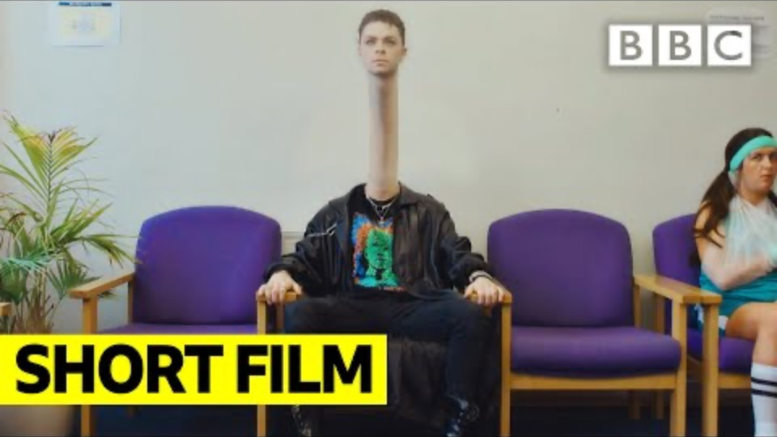
AZ of ni

