Slide 1
OBJECTIVITY + FAIRNESS
Bias and Agenda

Slide 2
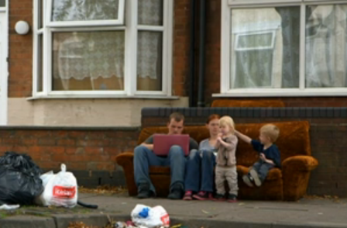
Objectivity and Fairness
Benefits Street: https://www.youtube.com/watch?v=mszhESGvE_c
Drowning in Plastic: https://www.bbc.co.uk/programmes/p06mfk49

Slide 3
Interview Technique
Creating your documentary

Slide 4
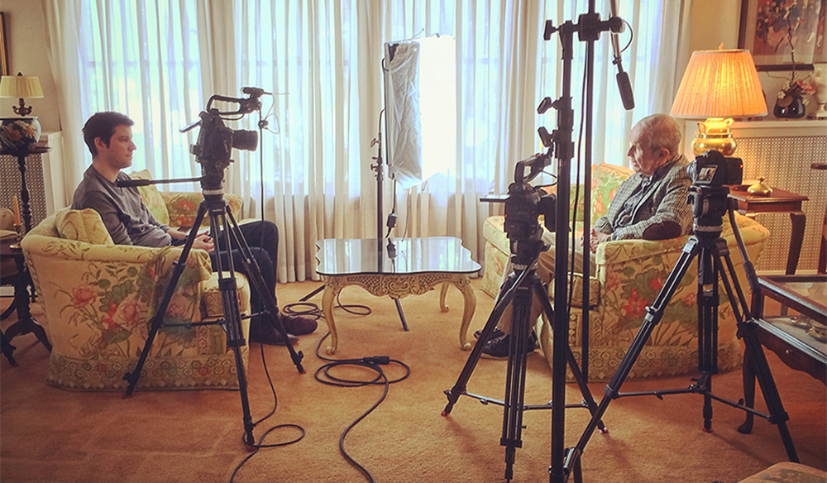
The Interview
The heart of the documentary
Use this to inform everything else
Looks easy – definitely isn’t!
Filming an interview is more than just filming someone answering questions. It requires a good interviewer, who understands the social aspects of interviewing and can make the interviewee feel at ease.

Slide 5
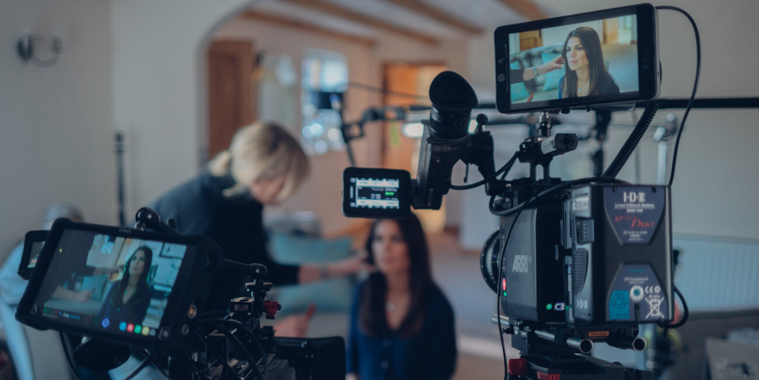
What makes a good interview?
In pairs, discuss what you think makes a good interview. An interview is just a person talking, so what are the features that make some interviews really exciting to listen to?

Slide 6
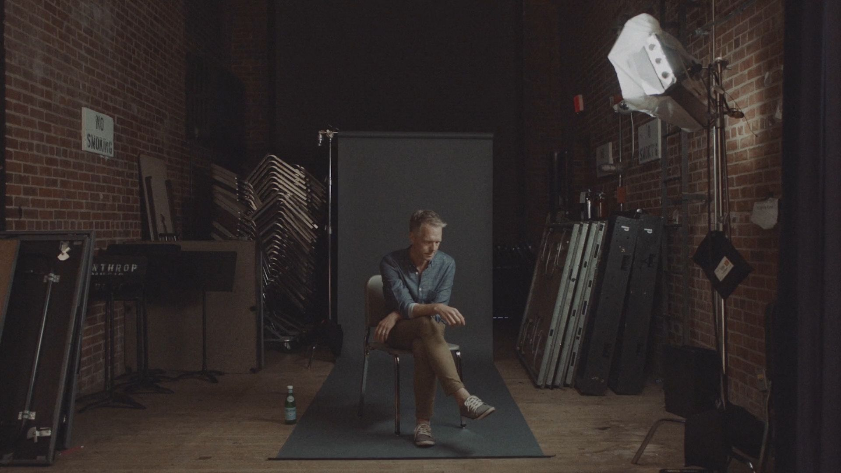
The Interviewee
First find a suitable Interviewee. The best interviewees are passionate and articulate when they speak. If you get bored listening to someone, chances are the audience for you film will be bored too!
If it’s possible to do so, have the Interviewee sign an Appearance Release before you begin filming. If it’s not possible, do it after the interview. An Appearance Release gives you permission to use the footage you shoot.

Slide 7
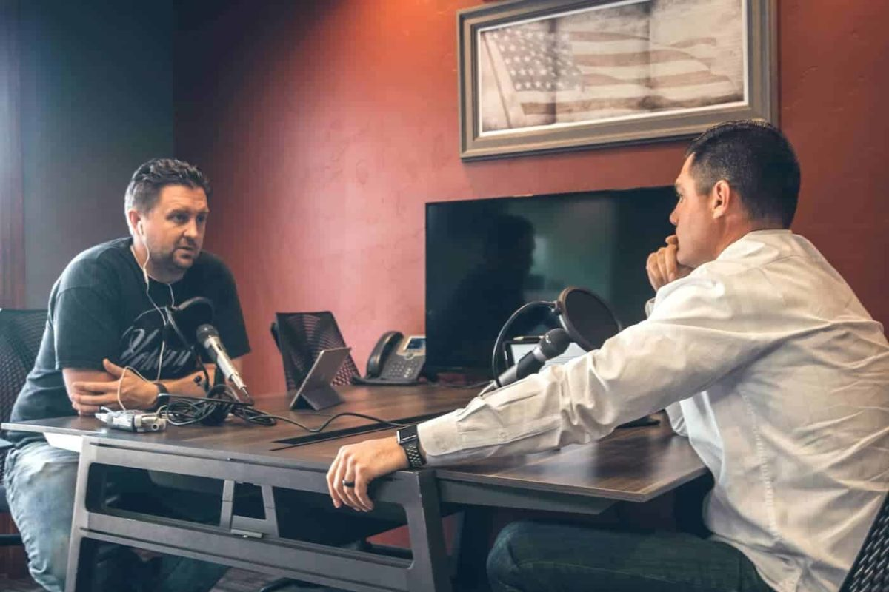
The Questions
Generate a list of questions to ask. What information do you want viewers to learn from the person you have chosen? Try to think of open-ended questions rather than ones that produce yes or no answers.

Slide 8
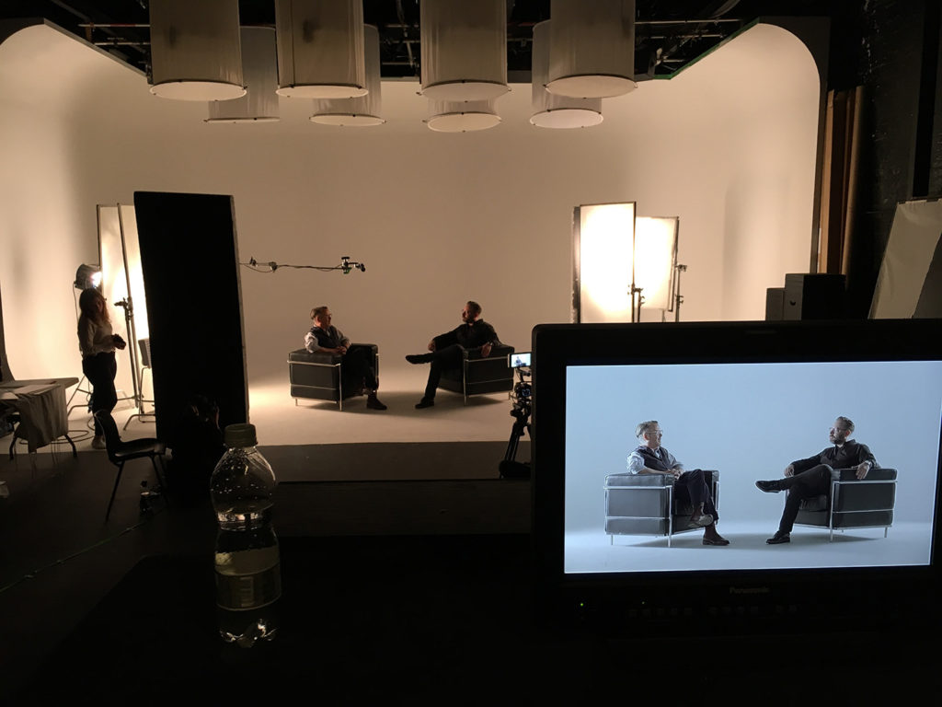
The Location
Think about where you will conduct the interview. How can the background communicate additional information about the person you are interviewing? Also take into account the proper lighting and sound that the place will allow.
Arrange to film your subject in the place you have chosen to conduct the interview.

Slide 9
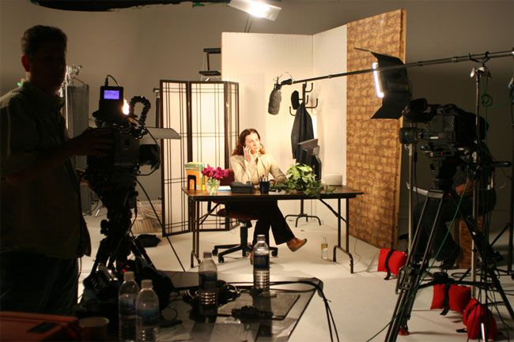
The Setup
Video: https://www.youtube.com/watch?v=7xHNqG54Bpg

Slide 10
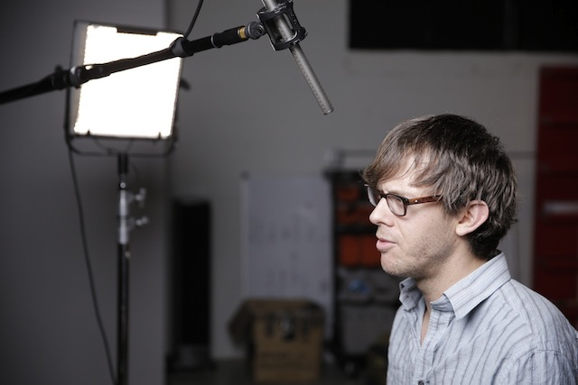
Hearing It
Don’t forget about sound
Always use a shotgun – use a lav mic as a backup
What are you recording into?
Remember your sync points
Don’t be inappropriate!
Remember to press record: and to stop…
https://www.premiumbeat.com/blog/how-to-shoot-professional-interviews/

Slide 11

To Zoom?
Zoom – record audio on your side, backup with Voice Notes!

Slide 12
Guidance for the Interviewer
Begin the interview. Feel free to use your list as a guide for the questions. Here are some pointers:
  Are you comfortable and sitting at the same level as your subject?
  Can you hear the subject?
  Are you showing respect?
  Are you asking clear, short questions?
  Are you asking leading questions - does your question suggest an answer that is more than “yes, no, or I don’t know”?
  Never ask questions that produce “yes or no” answers. Instead ask open-ended questions.
  Remind the Interviewee to speak in full sentences. Ask the Interviewee to repeat him/herself if necessary.
  Do not speak over the end of the Interviewee’s answer. Similarly, tell the Interviewee not to begin talking until you are
  done asking your question.
  Are you listening to what your subject is saying, and asking good follow-up questions based on the answers they have just given?
  Are you allowing enough time for the person to answer?
  Try to be silent in your acknowledgement while your subject is responding, by nodding or smiling,
  so that your voice doesn’t get recorded over the answer (don’t say “yes” or “uh-huh”).
  Is the interview flowing well, or does it jump from one subject to another without purpose?
  How does it sound? It may be worth doing a sound check before recording too much.
  Does it look as if your subject is enjoying the interview?
  Are you relaxed and maintaining eye contact? Maintain eye contact with the Interviewee at all times.
  This will prevent them from looking into the camera and keep them looking in the proper direction.
  Is your body language appropriate?
  Help the Interviewee to feel at ease. If he or she is nervous, it will show on camera.

Slide 13
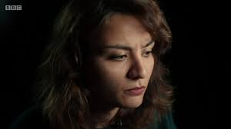
Concluding
Continue to roll at least 10 seconds after the interviewee answers the last question.
When you are finished with interview, thank your subject and replay the tape for him or her.

Slide 14
Videos
Alison Hammond: https://www.youtube.com/watch?v=bAb8KIhgVAI
Tarrantino: https://www.youtube.com/watch?v=GrsJDy8VjZk
Ayoade: https://www.youtube.com/watch?v=jjC3ycS_2js
Iraq: https://www.youtube.com/watch?v=eEjULW0_fMI

